Slide 1

Brain Algorithms READING GROUP SPRING, 2023
Meeting 1

Slide 2
Algorithmic Theory of Brain Behavior
Aim: Understand computation in the brain, in terms of abstract, interacting distributed algorithms.
Computational model based on weighted digraphs with nodes = neurons, operating synchronously in parallel.
Problems of attention, decision-making, similarity detection, clustering, visual recognition, and representation and learning of structured concepts.
Techniques from theoretical computer science.
Inspiration, validation from experimental neuroscience.
Notes:
Techniques from theoretical CS: distributed algorithms, complexity theory, concurrency theory.

Slide 3
Motivation
Biology:
Understand computational aspects of biological neural networks: models, algorithmic building blocks, limitations.
Computer science:
Similar problems arise in CS and AI.
Get a new perspective by studying them in biological networks.
Biological algorithms are flexible, robust, adaptive---also desirable properties for computer systems.
Notes:
Get a new perspective by studying these problems in the stochastic, noisy, resource-constrained setting of biological neural networks.

Slide 4
Our Work So Far
Uses synchronous, stochastic Spiking Neural Network (SNN) models.
We defined formal SNN models.
Identified abstract problems to be solved by SNNs.
Designed SNNs that solve the problems, analyzed them in terms of network size, convergence time, stability time.
Proved tradeoffs, lower bounds.
Collaborated with neuroscientists (Graybiel, Halassa) and neural network hardware developers (Berggren).

Slide 5
Selected Publications
Computational Tradeoffs in Biological Neural Networks: Self-Stabilizing Winner-Take-All Networks. Lynch, Musco, Parter. ITCS 2017, arXiv 2019.
Spike-Based Winner-Take-All Computation: Fundamental Limits and Order-Optimal Circuits. Su, Chang, Lynch. Neural Computation, December 2019.
Neuro-RAM Unit with Applications to Similarity Testing and Compression in Spiking Neural Networks. Lynch, Musco, Parter. DISC 2017.
Random Sketching, Clustering, and Short-Term Memory in Spiking Neural Networks. Hitron, Lynch, Musco, Parter. ITCS 2020.
Learning Hierarchically Structured Concepts. Lynch, Mallmann-Trenn. Neural Networks 2021.
A Compositional Model for Spiking Neural Networks. Lynch, Musco. Vaandrager Festschrift 2022.
Learning Hierarchically-Structured Concepts II: Overlapping Concepts, and Networks With Feedback. Lynch, Mallmann-Trenn. In progress.

Slide 6
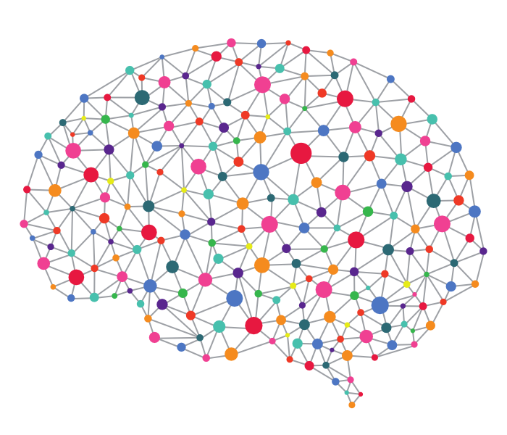
Spiking Neural Networks
Have bio-plausible features, but simple enough to study theoretically.
Each neuron fires in discrete spikes, in response to incoming membrane potential.
Potential is induced by spikes from neighboring neurons; influence can be excitatory or inhibitory.
Our model: Neurons operate in synchronous rounds, fire stochastically.
Notes:
Now describe our model.
Stochastic firing reflects noisiness of neural computation.
Inspiration for using SNNs came from Maass.
His work differs from ours in that he mostly considers asynchronous models that allow fine-grained control of parameters such as real-time delay of spikes.

Slide 7
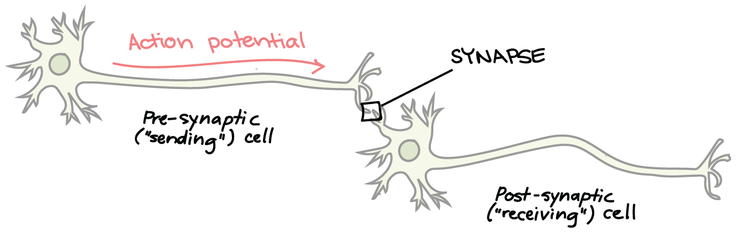
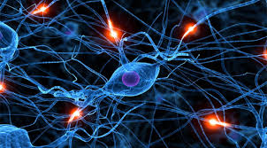
Our Basic SNN Model
Network structure: Weighted digraph, nodes represent neurons, edges represent synapses, weights represent synaptic strength.
$$u$$
$$v$$
Notes:
The first picture shows a synapse being modeled by an edge.
The second shows an entire brain being modeled by a graph.
Should be a directed graph.

Slide 8
SNN model
$$0$$
$$1$$
$$1$$
$$0$$
…
$$x1$$
$$x2$$
$$x3$$
$$xn$$
Network consists of:
Input, output, internal (auxiliary) neurons
Directed edges
Weights for edges
Activation bias for neurons
$$3$$
$$b=.5$$
$$b =1.5$$
$$as$$
$$ac$$
1
-1
$$b=3$$
$$y1$$
$$y2$$
$$y3$$
…
$$yn$$
2
Neurons have state.
In our basic model this is just the (Boolean) firing status.
Ignores biological features such as accumulated potential and refractory periods after firing.
Sometimes we add other state information.
Notes:
Allows self-loops
Positive weights are excitatory, negative weights are inhibitory.
Input neurons have no incoming edges from within $N.$
Their behavior is determined externally.
---------------------------------------------------
Memory:
Refractory period, delay, involve some memory of recent events.
In some of our newer results, we do allow some limited memory.
This required generalizing the model.

Slide 9
SNN model dynamics
Synchronous rounds.
Firing probability of a neuron at time $t$ depends on firing of incoming neighbors at time $t−1$:
$u_{t}=1: u$ fires at time $t.$
$pot\left(u,t\right)=Σ_{v} weight\left(v,u\right) v_{t−1 }– bias(u)$
$Pr⁡[u_{t}=1]$ $= 1/(1+e^{−pot\left(u,t\right)/λ})$
$λ=$ temperature (steepness)
Input is an infinite sequence of firing patterns of input neurons.
For a given input, network produces a probability distribution on executions.
Firing probability
1
1/2
$$Potential$$
Notes:
The summation here is over the incoming neighbors v of u.
Temperature parameter: Smaller values of lambda yield steeper functions.
With very small lambda, u acts similarly to a probabilistic threshold gate: prob of firing = ½ when potential = b(u), else 1 or 0.
To model reality, we might be forced to use particular values of $λ$, based on real neuron behavior.

Slide 10
This reading group:
Recent papers in the area of Brain Algorithms.
Mechanisms for key tasks such as memory and recall, focus and attention, decision-making, intuitive and symbolic thinking, prediction.
Recognition of structured concepts, novelty detection, neural assemblies.
Interaction with the real world: representations for position and motion, and their use in tasks such as orientation and navigation.
Model mechanisms formally as SNNs, analyze them.
General issues: composition, abstraction, general learning rules.
Schedule: Handout
Notes:
At this point, start asking for volunteers to present papers.
Finish this at the end of the meeting.

Slide 11
Review of some of our work
Winner-Take-All
Random projection, clustering, and short-term memory
Compositional modeling
Learning structured concepts

Slide 12
I: WINNER-TAKE-ALL
Notes:
Which brings us, finally, to the current paper, on compositional modeling.

Slide 13
Winner-Take-All in SNNs
Lynch, Musco, Parter. Winner-Take-All computation in Spiking Neural Networks. Arxiv:1904:12591v1, April, 2019.
Su, Chang, Lynch. Spike-based Winner-Take-All Computation: Fundamental Limits and Order-Optimal Circuits. Neural Computation, 2019.
$$0$$
$$1$$
$$1$$
$$0$$
…
$$x1$$
$$x2$$
$$x3$$
$$xn$$
WTA Circuit
…
$$y1$$
$$y2$$
$$y3$$
$$yn$$

Slide 14











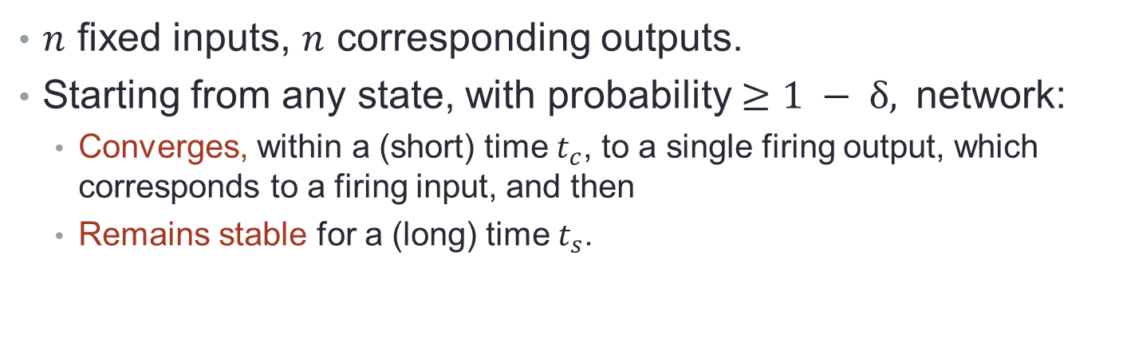


Winner-Take-All$: WTA\left(n,t_{c}, t_{s}, δ\right)$
$n$ fixed inputs, $n$ corresponding outputs.
Starting from any state, with probability $≥1 − δ,$network:
Converges, within a (short) time $t_{c}$, to a single firing output, which corresponds to a firing input, and then
Remains stable for a (long) time $t_{s}$.
$$0$$
$$1$$
$$1$$
$$0$$
A neural “leader election” problem, studied in computational neuroscience.
Used in perceptual attention, competitive learning,…
…
$$x1$$
$$x2$$
$$x3$$
$$xn$$
WTA Circuit
…
$$y1$$
$$y2$$
$$y3$$
$$yn$$
Notes:
This is binary version of the problem.
We have also considered more elaborate versions, where each input fires with some “rate”, formalized in terms of the parameter of a Bernoulli process.
We will see that shortly.
Here delta is the error probability. The probability statements are with probability at least 1 – delta.
Self-stabilizing:
Since the network can start from any state.
----------
Competitive learning:
Competitive learning is a form of unsupervised learning in ANNs, in which nodes compete for the right to respond to a subset of the input data. A variant of Hebbian learning, competitive learning works by increasing the specialization of each node in the network.

Slide 15

WTA results
We defined and analyzed SNNs that solve the WTA problem, and studied tradeoffs between network size, convergence time, and failure probability.
Designed a simple solution with two internal inhibitor neurons, converges in expected $O(log⁡n)$ rounds, remains stable for a “long time”.
Lateral inhibition strategy: firing outputs excite the inhibitors, which fire and suppress some outputs.
Proved a lower bound result for 2-inhibitor constructions, and an impossibility result for 1-inhibitor.
Showed faster convergence with more inhibitors.
Notes:
Same network depicted earlier, in describing the model work.

Slide 16


















Simple solution with two inhibitors
Two inhibitors play different roles: convergence inhibitor $a_{c}$ drives convergence to a single firing output, whereas stability inhibitor $a_{s}$ensures that the output stabilizes.
Convergence inhibitor $a_{c}:$
Fires with high probability whenever $≥2$ outputs fire.
Causes any output that fires at time $t$ to fire at time $t+1$ with probability $\sim ½.$
Stability inhibitor $a_{s}:$
Fires with high probability whenever $≥1$ outputs fire.
Prevents outputs that didn’t fire at time $t$ from firing at time $t+1.$
$$0$$
$$1$$
$$1$$
$$0$$
…
$$x1$$
$$x2$$
$$x3$$
$$xn$$
$$b=.5$$
$$as$$
$$ac$$
$$b =1.5$$
$$y1$$
$$y2$$
$$y3$$
…
$$yn$$
Notes:
When no outputs are firing, the inhibitors don’t fire (WHP). So that encourages all the outputs corresponding to firing inputs to fire.
Once the convergence inhibitor stops firing, a currently firing output continues to fire.
Its self-loop helps to keep it going.
But the stability inhibitor provides enough inhibition to prevent outputs that didn’t fire at time t from firing at time t+1.

Slide 17


Simple solution with two inhibitors
Main idea: Approximately half of currently-firing outputs stop firing at each step.
So with constant probability, there is some time $t_{c} ≤\log{n}$ such that exactly one output fires at time $t_{c}.$
Moreover, after time $t_{c}$, with high probability, the selected output continues to fire for a long time $t_{s}$.
During this stable period, only $a_{s}$fires, preventing all other outputs from starting to fire.
$$0$$
$$1$$
$$1$$
$$0$$
…
$$x1$$
$$x2$$
$$x3$$
$$xn$$
$$b=.5$$
$$as$$
$$ac$$
$$b =1.5$$
$$y1$$
$$y2$$
$$y3$$
…
$$yn$$
Notes:
Note that convergence is achieved in one pass just with constant probability, not high probability. If it fails, then this repeats. A constant number of tries should succeed WHP.
This mechanism is “self-stabilizing”, meaning that it works starting from any state. That is important if we want to say that this just repeats if it fails.

Slide 18







Simple solution with two inhibitors
Output neuron bias (threshold) $= 3.$
Weights of (input, output) edges $= 3.$
Weights of output self-loops $= 2.$
Weights of (output, inhibitor) edges $= 1.$
Weights of (inhibitor, output) edges = $−1.$
$$0$$
$$1$$
$$1$$
$$0$$
…
$$x1$$
$$x2$$
$$x3$$
$$xn$$
$$3$$
$$b=.5$$
$$b =1.5$$
$$as$$
$$ac$$
1
-1
$$b=3$$
$$y1$$
$$y2$$
$$y3$$
…
$$yn$$
2
Notes:
Filling in more of the details…
Add biases for the output neurons, and weights for all edges.
Technically, this uses temperature parameter lambda = 1, whereas the sigmoid function would allow more general values of lambda.
Weights are the same for same types of neurons.
That is, each type of arrow (input to output, output to self, output to inhibitor, and inhibitor to output) has one weight everywhere that type of edge appears.
So we have a built-in symmetry in the network. Symmetry gets broken using randomness.

Slide 19
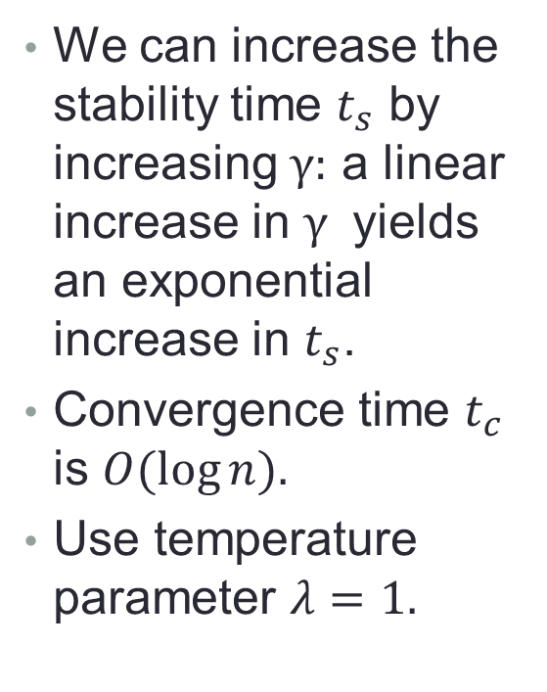







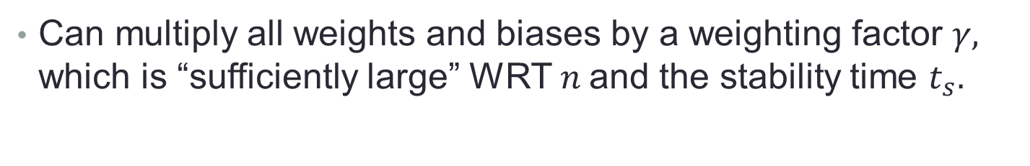

Include a Weighting Factor $γ$
Can multiply all weights and biases by a weighting factor $γ,$ which is “sufficiently large” WRT $n$and the stability time $t_{s}.$
We can increase the stability time $t_{s}$ by increasing $γ:$ a linear increase in $γ$ yields an exponential increase in $t_{s}$.
Convergence time $t_{c}$ is $O(\log{n).}$
Use temperature parameter $λ=1.$
$$0$$
$$1$$
$$1$$
$$0$$
…
$$x1$$
$$x2$$
$$x3$$
$$xn$$
$$3γ$$
$$b=.5γ$$
$$b =1.5γ$$
$$as$$
$$ac$$
$$γ$$
$$−γ$$
$$b=3γ$$
$$y1$$
$$y2$$
$$y3$$
…
$$yn$$
$$2γ$$
Notes:
Weighting factor:
This is the same network, only now all the weights and biases are multiplied by a parameter $γ$.
$$.$$
This is the version I will assume from now on.
We require that $γ$ is $Ω(\log\left(n t_{s}\right))$, where $t_{s}$is the stability time.
That means we can increase the stability time by increasing $γ$, specifically, a linear increase in $γ$ yields an exponential increase in $t_{s}$.
The convergence time $t_{c}$ doesn’t depend directly on $γ,$ though.
----------
Weighting vs. temperature parameter:
As an alternative to using a weighting factor $γ,$we could have adjusted the temperature parameter $λ$ in the exponent I the denominator of the sigmoid function.
These are “equivalent” in a sense; we have a sketch of an equivalence theorem in the paper, section 2.4.

Slide 20

Our Main Theorem
Theorem 1: Assume $γ ≥ c log({n}t_{s} /δ$). Then starting from any state, with probability $≥1 − δ,$the network converges, within time $t_{c}≈c\log{n}\log\left(\frac{1}{δ}\right)$, to a single firing output corresponding to a firing input, and remains stable for time $t_{s}$.
Also:
Expected time result.
More than two inhibitors can be used to give faster convergence.
Can’t solve the problem much faster with just two inhibitors.
Can’t solve it at all with one inhibitor.
$$0$$
$$1$$
$$1$$
$$0$$
…
$$x1$$
$$x2$$
$$x3$$
$$xn$$
$$3γ$$
$$b=.5γ$$
$$b =1.5γ$$
$$as$$
$$ac$$
$$γ$$
$$b=3γ$$
$$y1$$
$$y2$$
$$y3$$
…
$$yn$$
$$2γ$$
Notes:
More formally…
The c is just some constant, specified in the paper but not here.
The weighting factor must be big enough, larger if we want a longer stabilization time.
The weighting factor need grow only logarithmically with the stabilization time $t_{s}$.
Note that here we have introduced the failure probability delta as well; I am mostly ignoring that in this talk, but of course all the results depend on that.
The convergence time $t_{c}$is roughly log n in any case.
Again, I am ignoring the error probability $δ$ in this informal description.
----------
Other results:
We also have an expected time version of the result, which is somewhat simpler.
We have a variation on the network that uses more inhibiters and converges faster.
And two impossibility results!

Slide 21















Lower Bounds
Based on a somewhat restricted version of the model:
Inputs connect to no outputs except their own.
Outputs do not connect to each other.
Auxiliary neurons are all inhibitors.
Symmetric weights.
These conditions are satisfied by our algorithms.
Proofs depend on locality arguments, common in distributed computing theory.
$$0$$
$$1$$
$$1$$
$$0$$
$$x1$$
$$x2$$
$$x3$$
…
$$xn$$
$$a1$$
$$a2$$
$$am$$
$$y1$$
$$y2$$
$$y3$$
…
$$yn$$
Notes:
These conditions can be weakened.
But I’ll use the stronger versions here, just to give you the flavor of the arguments.
Symmetry:
The 2-inhibitor lower bound proof depends on symmetry.
The 1-inhibitor impossibility result in the paper doesn’t use symmetry, but it may be easier to see this way.
These are conditions that are satisfied by our algorithm.
Seem fairly reasonable.
Auxiliary neurons need not be inhibitors. But would have to modify the proof a bit.

Slide 22


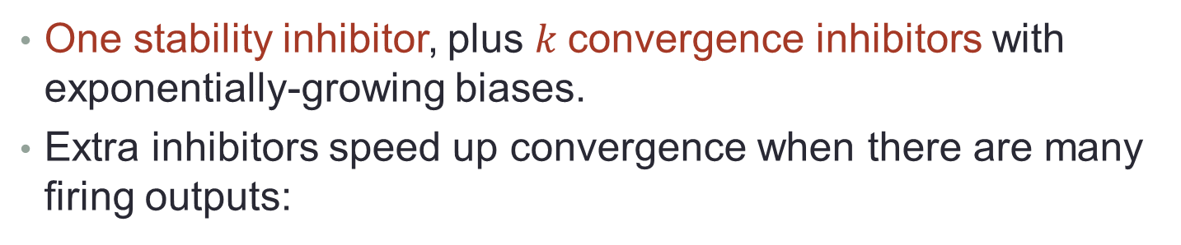







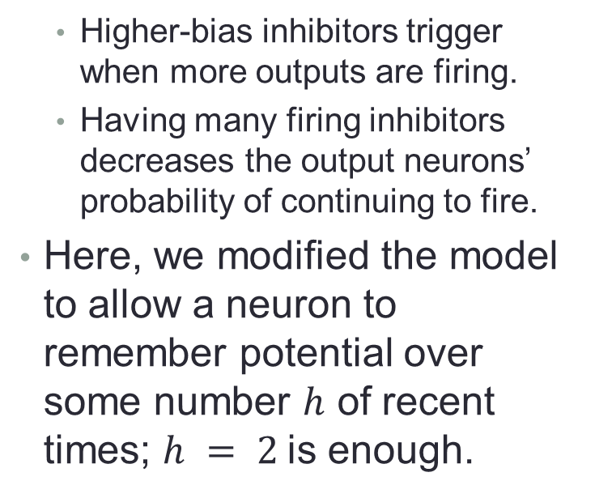


Faster Solution with More Inhibitors
One stability inhibitor, plus $k$convergence inhibitors with exponentially-growing biases.
Extra inhibitors speed up convergence when there are many firing outputs:
0
1
1
0
Higher-bias inhibitors trigger when more outputs are firing.
Having many firing inhibitors decreases the output neurons’ probability of continuing to fire.
Here, we modified the model to allow a neuron to remember potential over some number $h$ of recent times; $h = 2$is enough.
…
$$x1$$
$$x2$$
$$x3$$
$$xn$$
…
$$a1$$
$$a2$$
$$ak+1$$
…
$$y1$$
$$y2$$
$$y3$$
$$yn$$
Notes:
Model technicality:
This solution uses a slightly modified model, with a slightly richer state in each neuron that is allowed to record a little history. Rather than just Boolean, firing or not.
The history helps to avoid some race conditions that arise because of the lag time. These were annoying in the previous result, but are worse here.
Q: Why would these race conditions be worse here? Worse enough that we wanted to change the model?
A: Roughly, in the two inhibitor network, when both inhibitors fire, the outputs drop out with probability 1/2. This means that even if both inhibitors fire and only one output fires, with probability 1/2, the output will still fire in the next round. This lets us go from near-valid WTA to valid WTA with probability 1/2.
In the faster networks, outputs drop out with higher probability. E.g. if there are n firing outputs, each might drop out with probability roughly 1 - 1/n. This means that if one output fires, but the number of inhibitors has not “caught up” and still reflects n outputs firing, there is only an approximately 1/n chance that the one output continues firing, thus allowing us to go from near-valid to valid WTA. So this is why the race condition issue matters more in these faster networks and why we need to augment the model with history to avoid it.
----------
Improvement:
Here k > 1.
High-probability convergence time, resulting from using k convergence neurons, is now log n to the power 1/k.

Slide 23


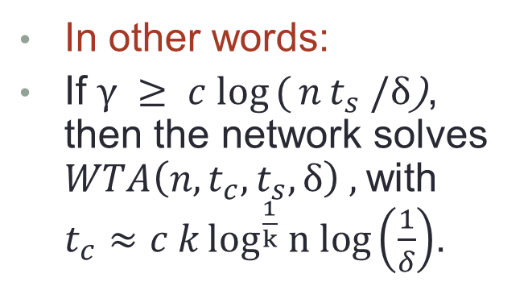

Faster Solution with More Inhibitors
Theorem 4: Assume $γ ≥ c log({n}t_{s} /δ$). Then from any state, with probability $≥1 − δ,$ the network converges, within time
$t_{c}≈c k\log^{\frac{1}{k}} n log\left(\frac{1}{δ}\right)$, to a single firing output corresponding to a firing input, and remains stable for time $t_{s}$.
0
1
1
0
$$x1$$
$$x2$$
$$x3$$
…
$$xn$$
$$a1$$
$$a2$$
$$ak+1$$
In other words:
If $γ ≥ c log({n}t_{s} /δ$), then the network solves $WTA\left(n,t_{c}, t_{s}, δ\right) ,$with $t_{c}≈c k\log^{\frac{1}{k}} n log\left(\frac{1}{δ}\right)$.
$$y1$$
$$y2$$
$$y3$$
…
$$yn$$
Notes:
The second bullet is restating the theorem in terms of the WTA() notation.
The first version unwinds the definition and may be easier to read.
----------
The thing to notice here is the exponent of 1/k for the log.
For example, if k = 1, this corresponds to one convergence inhibitor.
Then the bound is c log n log(1/delta), same as before.
If k = 2, we get a factor of sqrt(log n) for convergence time.
Etc. For k convergence inhibitors, we get log^(1/k).
And in our full paper we sketched a lower bound tradeoff (but we still should go over that and improve the proof).

Slide 24
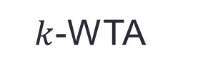
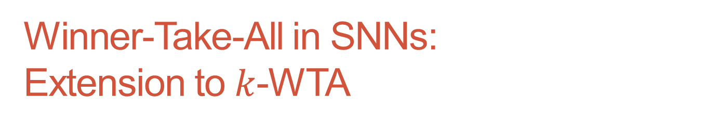
Winner-Take-All in SNNs: Extension to $k$-WTA
Su, Chang, Lynch. Spike-based Winner-Take-All Computation: Fundamental Limits and Order-Optimal Circuits. Neural Computation 2019.
…
$$x1$$
$$x2$$
$$x3$$
$$xn$$
$k$-WTA
…
$$y1$$
$$y2$$
$$y3$$
$$yn$$

Slide 25
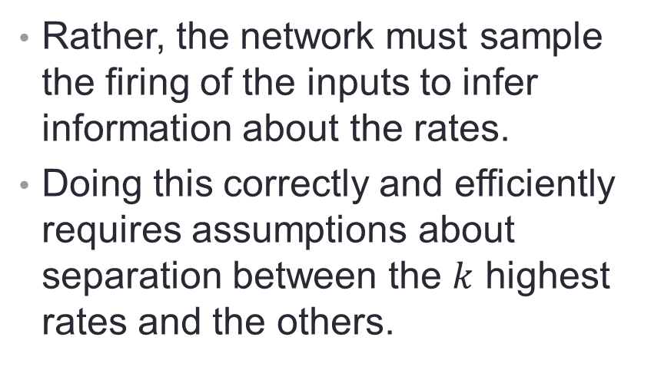

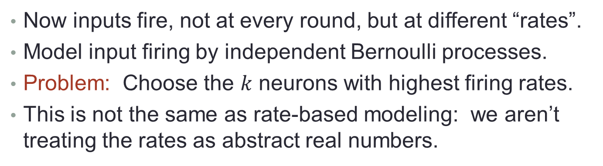
Extension to $k$-WTA
Now inputs fire, not at every round, but at different “rates”.
Model input firing by independent Bernoulli processes.
Problem: Choose the $k$ neurons with highest firing rates.
This is not the same as rate-based modeling: we aren’t treating the rates as abstract real numbers.
Rather, the network must sample the firing of the inputs to infer information about the rates.
Doing this correctly and efficiently requires assumptions about separation between the $k$ highest rates and the others.
…
$$x1$$
$$x2$$
$$x3$$
$$xn$$
$k$-WTA
…
$$y1$$
$$y2$$
$$y3$$
$$yn$$
Notes:
This is different from rate-based modeling, which is something we will study in a while (class 6).
We are not treating the rates as abstract real numbers to be used in computations.
Rather, just firing at different times, as governed by Bernoulli processes.
So the network must sample the firing of the inputs to infer information about the rates.
The problem is now to choose the k neurons with the largest firing rates.
The network must sample these inputs, and use what it learns to push the decision toward the highest-rate firing neurons.
To be able to do this correctly and efficiently requires some assumptions about separation between the k highest rates and the rest.

Slide 26

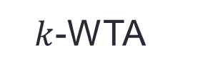






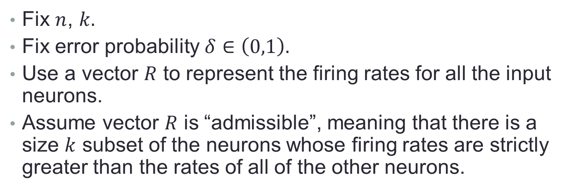


Extension to $k$-WTA
Fix $n$, $k.$
Fix error probability $δ∈\left(0,1\right).$
Use a vector $R$ to represent the firing rates for all the input neurons.
Assume vector $R$ is “admissible”, meaning that there is a size $k$ subset of the neurons whose firing rates are strictly greater than the rates of all of the other neurons.
…
For a vector $R$ of possible rates for all inputs, define $T_{R}$ to be a certain statistic, capturing the “minimum distance” between different rates in $R$ (related to KL-divergence).
$$x1$$
$$x2$$
$$x3$$
$$xn$$
$k$-WTA
…
$$y1$$
$$y2$$
$$y3$$
$$yn$$
Notes:
Technicality:
We have an admissibility assumption for rate assignments R.
The rates can be chosen to be the same at different input neurons, but there must be a separation between the k highest rates and the rest.
That is, there must be some unambiguous right answer.
----------
KL-divergence = Kullback-Leibler divergence, used to measure dissimilarity between two discrete distributions.

Slide 27

Lower Bound
Lower bound theorem: There is no algorithm that solves $k$-WTA with error probability $δ$, for all rate assignments from $R$, and that converges within time
$\left(\left(1−δ\right)\log\left(k\left(n−k\right)\right)−1\right)T_{R}.$
Proof based on information theory.
Does not depend on the particular SNN model; in fact, the result would still apply to a centralized algorithm.
Depends just on the difficulty of sampling.
…
$$x1$$
$$x2$$
$$x3$$
$$xn$$
$k$-WTA
…
$$y1$$
$$y2$$
$$y3$$
$$yn$$
Notes:
The network needs to spend enough time sampling to get sufficiently reliable info about the k largest.
This leads to a lower bound.
The bound we have is information-theoretic, has nothing to do with the fact that we are using our particular kind of network, in fact, could have a centralized algorithm.
It depends on just the difficulty of sampling.
Proof is in the Appendix of the paper.
The bound in the paper has an additional +1 within the log, but that doesn’t seem significant; I’ve left it out here.
----------
Tightness of bound:
This bound doesn’t actually capture the best dependence on delta that should be possible, for fixed n and k.
In particular, as delta gets smaller and smaller, the time required should get unboundedly large (?).
TBD. Need some result about statistical sampling (hypothesis testing).

Slide 28







Upper Bound
Uses a particular SNN model.
Structure: Inputs excite corresponding outputs; outputs inhibit each other (in a clique).
Neuron state: Expand to include limited memory: for each of the most recent $m$ times, remember the incoming potential.
$$x1$$
$$x2$$
$$x3$$
$$v1$$
$$v2$$
$$v3$$
…
$$y2$$
$$w(v1,u)$$
$$u$$
$$y1$$
$$y3$$
Notes:
The upper bound, of course, does depend on the model.
We use a variant of our SNN model, with m memory of previous incoming potentials.
m then becomes a parameter in the analysis results.

Slide 29
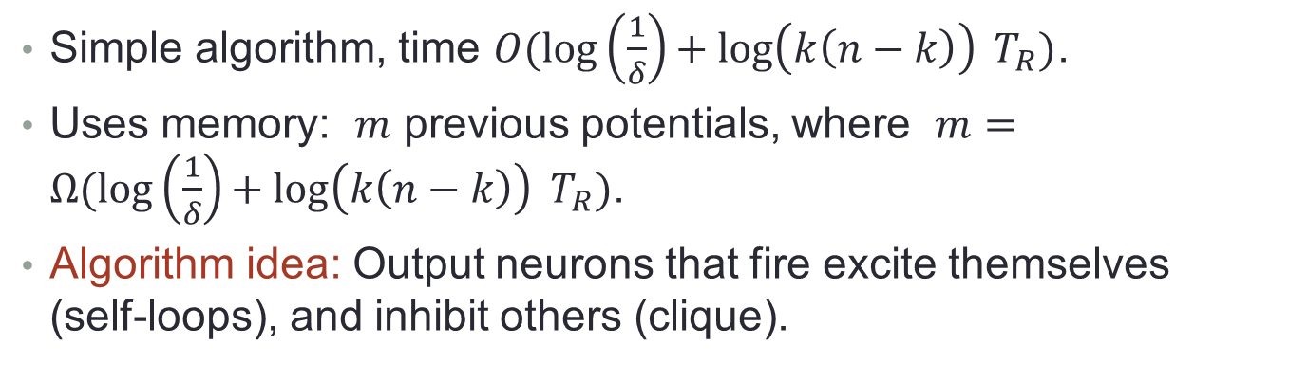
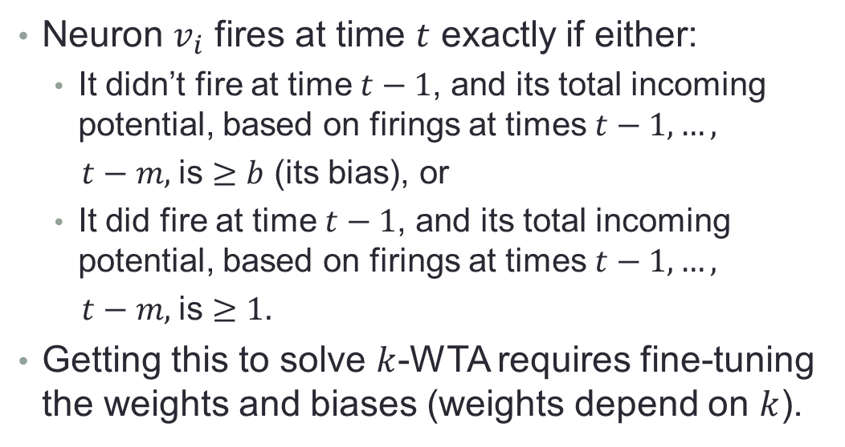
Upper Bound
Simple algorithm, time $O(\log\left(\frac{1}{δ}\right)+ log\left(k\left(n−k\right)\right) T_{R})$.
Uses memory: $m$ previous potentials, where $m=Ω(\log\left(\frac{1}{δ}\right)+ log\left(k\left(n−k\right)\right) T_{R})$.
Algorithm idea: Output neurons that fire excite themselves (self-loops), and inhibit others (clique).
Neuron $v_{i}$ fires at time $t$ exactly if either:
It didn’t fire at time $t−1$, and its total incoming potential, based on firings at times $t−1,…,$
$t−m,$is $≥b$ (its bias), or
It did fire at time $t−1$, and its total incoming potential, based on firings at times $t−1,…,$
$t−m,$is $≥1.$
Getting this to solve $k$-WTA requires fine-tuning the weights and biases (weights depend on $k$).
$$x1$$
$$x2$$
$$x3$$
$$y2$$
$$y1$$
$$y3$$
Notes:
And we have a simple algorithm with a bound that is reasonably closely matching, this time with the “right kind of” dependence on delta.
Uses memory.
Bound depends on the same distance metric T_R as in the lower bound.
----------
Network connections:
Output neurons have self-loops, and are connected in a clique.
When they fire, they excite themselves, and inhibit others.
(Technically this allows neurons to both excite and inhibit, but this capability could be removed by interposing an extra neuron (excite an inhibitor)..)
Weights on the inhibitory edges are approx. – 1/k.
----------
Algorithm operation:
Each output neuron v_i examines its recent incoming potential, which comes from its corresponding input, from itself via an excitatory self-loop, and from the other output neurons via inhibitory edges. If that is sufficiently high, it will fire again.
Enough inhibition (from k neurons) will cause other neurons to not fire.
Too little inhibition will allow firing.
Breaking this down into two cases:
If the neuron hasn’t just fired, then it needs excitation from the input neuron and not much inhibition, to fire.
On the other hand, if the neuron has just fired, it can tolerate some more inhibition and keep firing.
This all has to be balanced, fine-tuned to make it work, that is, to converge to EXACTLY k firing outputs.
Where does k enter into the network definition? The weights are approx. 1/k.
Theorem: Algorithm guarantees…
---------------------------------------------------------------------------------------------------------------------------------------------------------

Slide 30
Ii: Random projection, clustering, and short-term memory
Hitron, Lynch, Musco, Parter. Random projection, clustering, and short-term memory in SNNs. ITCS 2020
Notes:
Which brings us, finally, to the current paper, on compositional modeling.

Slide 31
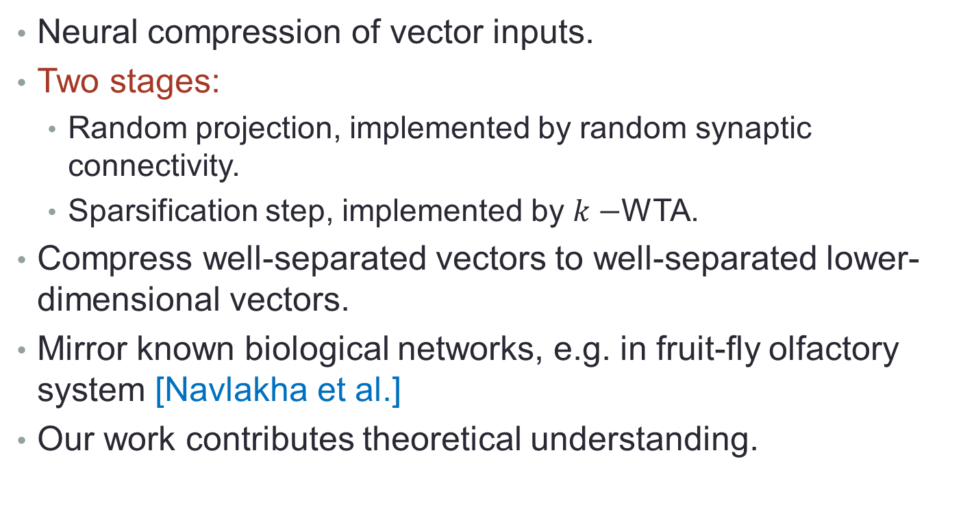
Random projection, clustering, and short-term memory
Neural compression of vector inputs.
Two stages:
Random projection, implemented by random synaptic connectivity.
Sparsification step, implemented by $k−$WTA.
Compress well-separated vectors to well-separated lower-dimensional vectors.
Mirror known biological networks, e.g. in fruit-fly olfactory system [Navlakha et al.]
Our work contributes theoretical understanding.
Notes:
Our work contributed a theoretical understanding of such networks, and helps to lay a foundation for understanding random compression in biological networks.

Slide 32
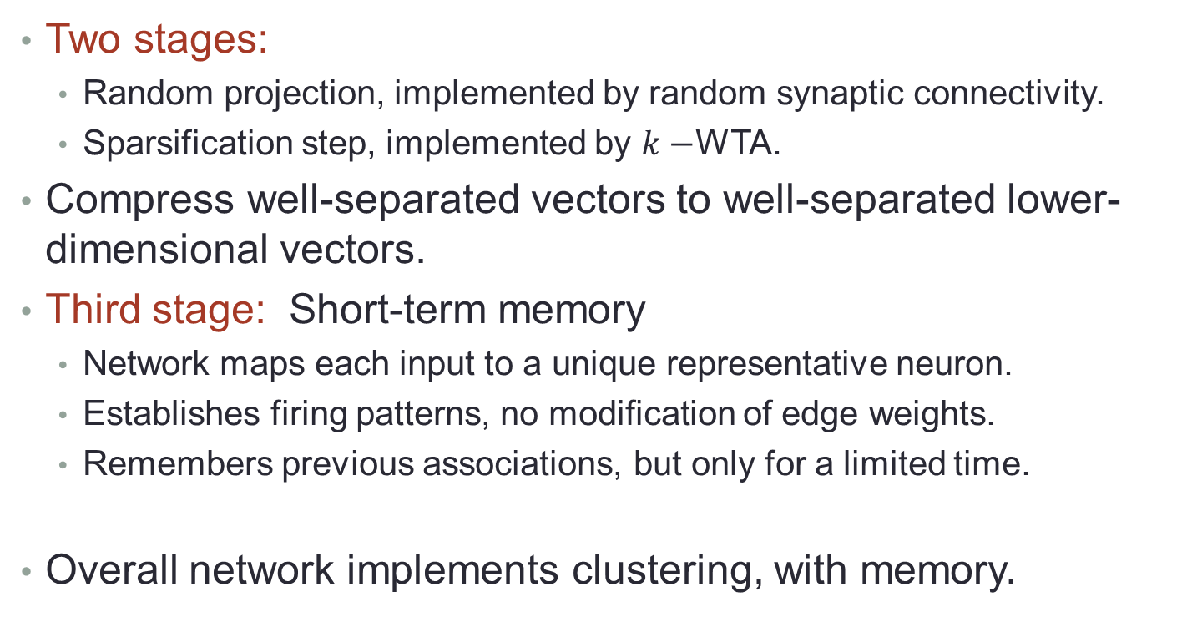
Random projection, clustering, and short-term memory
Two stages:
Random projection, implemented by random synaptic connectivity.
Sparsification step, implemented by $k−$WTA.
Compress well-separated vectors to well-separated lower-dimensional vectors.
Third stage: Short-term memory
Network maps each input to a unique representative neuron.
Establishes firing patterns, no modification of edge weights.
Remembers previous associations, but only for a limited time.
Overall network implements clustering, with memory.
Notes:
Getting unique representing neurons requires remembering previous associations.
Memory persists for a limited time, unless it is reinforced.
So here, short-term memory is represented by setting up firing patterns.
Latr in the term we will see another idea, on “short-term synaptic plasticity”.

Slide 33
Iii: A compositional Model FOR Spiking Neural Networks
Lynch, Musco.
A Compositional Model for Spiking Neural Networks.
arXiv 1808.03884v2, 2021. Vaandrager Festschrift 2022.

Slide 34
Compositional Model for Spiking Neural Networks
Lynch, Musco. A Compositional Model for Spiking Neural Networks. arXiv 1808.03884v2, 2021.
Also see:
Andres E. Lombo, Jesus E. Lares, Matteo Castellani, Chi-Ning Chou, Nancy Lynch, Karl K. Berggren. A Superconducting Nanowire-based Architecture for Neuromorphic Computing. Neuromorphic Computing and Engineering. Also, arXiv:2112.08928
Notes:
Also implemented in a simulator by Jesus Lares, Andres Lombo, et al., in Karl Berggren’s group, in order to simulate their nanowire-based SNN hardware.

Slide 35
Compositional Model for SNNs
Formal math foundation for modeling and reasoning about synchronous, stochastic SNNs.
Basic model: Neuron state contains firing status only.
External behavior of an SNN.
Composition operator, supports modeling SNNs as combinations of smaller SNNs.
Hiding operator, reclassifies some outputs as internal.
Proved that these operators respect external behavior.
General notion of a problem to be solved by an SNN.
Proved that the operators respect the problems solved.
Notes:
We are developing concurrency-theory foundations for SNN-based algorithms.
In our basic model, a neuron state contains firing status only (Boolean, firing/not-firing).
This paper deals with just the basic model.
Some of our algorithmic work uses extensions to the basic model, in which neurons have more elaborate state:
History of firing or potential.
Modes of operation, e.g., ready-to-learn.
Future work should involve extending the definitions and results of this paper to accommodate such extensions.
-----------------------------------------------------
Definitions and results:
Theorems saying that these operators respect the external behavior: e.g., external behavior of composition of networks depends only on the external behavior of the individual networks, and not on any internal behavior.

Slide 36
Composition Operator
Supports combining networks that solve simple problems into larger networks that solve more complex problems.
Lesson from some of our earlier work on Probabilistic I/O Automata: To get compositionality, we must resolve nondeterminism carefully.
Here, synchrony removes all timing nondeterminism, internal choices are stochastic; nondeterminism is limited to input.
Example: Attention network:
Allows the brain to focus on one input stream out of several that arrive in parallel.
Composed of a WTA that selects one stream, and a Filter network that passes on inputs from selected streams.
$${ w}_{1}$$
$${ w}_{2}$$
$${ w}_{3}$$
$${ x}_{1}$$
WTA
$$y_{1}$$
Filter
$$x_{2}$$
$$y_{2}$$
$$x_{3}$$
$$y_{3}$$
$${ z}_{1}$$
$${ z}_{2}$$
$${ z}_{3}$$
Notes:
We would like to be able to describe neural networks compositionally---that would certainly make the algorithms easier to understand.
It’s an open question to see where real brain activities follow such decomposition.

Slide 37
1. The SNN Model
Firing pattern for a set $V$of neurons: Maps $V$ to$\left\{0,1\right\},$ where $1 i$ndicates “firing”.
SNN consists of:
$N,$neurons, partitioned into $N_{in}, N_{out}, N_{int}$.
$N_{ext}= N_{in}∪ N_{out}$.
Each non-input neuron has a real-valued $bias.$
$E$, directed edges between neurons.
Input neurons have no incoming edges.
Allow self-loops on non-input neurons.
Each edge has a real-valued $weight.$
$F_{0}$, initial firing pattern for non-input neurons.
Notes:
And now, a few details.
This follows the general style used for I/O automata modes, but with input/output neurons instead of input/output actions.

Slide 38
Executions
Configuration: Firing pattern for the entire set $N$ of neurons.
Project configuration $C$ on any subset $M$ of $N$, $C ⌈ M.$
Initial configuration$:$ $C ⌈ {{(N}_{out} ∪ N_{int}\text{)} = F}_{0}$.
Network operates in synchronous rounds.
Execution: Finite or infinite sequence $C_{0},C_{1},…$where $C_{0}$ is an initial configuration.
Project execution $α$ on any subset$M$ of $N$, $α ⌈ M.$
$Trace\left(α\right)=α ⌈ N_{ext}.$
Trace of the network : Trace of any execution.
Notes:
Configurations:
Input configuration, output configuration, internal configuration, external configuration, non-input (lc) configuration.
Initial values for the lc (output and internal) neurons are as specified for the initial firing pattern.
----------------------------------------------------
Executions:
Executions are not probabilistic---they just describe what happens in one run of the network.
Here we allow any sequence of configurations---we have no “transition function” to restrict these.
This is because all configurations are possible---any firing behavior has some nonzero probability of occurring, however small.
Length of $C_{0},C_{1},…,C_{t}$= $t.$

Slide 39
Probabilistic Executions
Define a probabilistic execution for any infinite input execution $β_{in}.$
A probability distribution $P$ on the set of infinite executions consistent with $β_{in}.$
All start with the same initial configuration $C_{0}.$
Based on defining probabilities for “cones” $A(α)$, for all finite executions $α$ that are consistent with $β_{in}.$
$A\left(α\right)=$infinite executions that are consistent with $β_{in}$ and extend $α:$
$$A(α)$$
$$α$$
Notes:
What we discussed so far was not probabilistic, just a single execution.
Now we introduce probabilities.
We want a probability distribution on executions; this means we must remove all nondeterminism.
To do this, we fix the input execution beta_in.
Which executions to consider?
Those consistent with beta_in.
We say that infinite execution alpha is consistent with beta_in if alpha \lceil N_in = beta_in.
For a finite execution, alpha \lceil N_in should be a prefix of = beta_in.
Same initial configuration because we use the first (input) config from beta_in and F_0 for all the non-input neurons.
The general style of the definitions follows Segala’s work.

Slide 40
External Behavior
The external behavior of an SNN N, $Beh\left(N\right), \text{maps} \text{each} \text{infinite} \text{input} \text{execution} β_{in} \text{to} \text{a} \text{probability} \text{distribution} \text{on}\text{ (}\text{external}\text{) }\text{traces}\text{.}$
Formally, maps each $β_{in}$ to the collection of cone probabilities $\left\{P\left(A\left(β\right)\right)\right\},$ for finite traces $β$that are consistent with $β_{in}.$
We prove that $Beh$ is compositional: The external behavior $Beh$ of a composed network is determined by the external behaviors $Beh$ of the sub-networks.
Notes:
That is, for each infinite input execution, we get the probability distribution on executions, concretely expressed in terms of the cone probabilities.
We project this on the external neurons to get a probability distribution on the (external) traces.
In the rest of the talk, I define the needed notions and state the compositionality results.

Slide 41
2. Composition of SNNs $N^{1}$and $N^{2}$:
Compatibility:
No internal neuron of $N^{1}$ is a neuron of $N^{2},$ and vice versa.
No neuron is an output neuron of both $N^{1}$and $N^{2}.$
($N^{1}$and $N^{2}$may have common input neurons, and outputs of one may be inputs of the other.)
Composition $N=N^{1}×$ $N^{2}$ of compatible networks:
Take unions for neurons, output neurons, internal neurons.
An input neuron of one network that is an output of the other becomes an output in $N;$ other inputs remain inputs in $N$.
Take union for the edges.
Initial non-input firing pattern of $N$ is inherited from those of $N^{1}$and $N^{2}.$
Notes:
Two networks, for simplicity.
We can generalize to more networks, or just use repeated 2-network composition.
---------------------------------------------------------------
Compatibility:
These natural conditions are directly inspired by those used in I/O automata models.
Composition definition:
Since $N=N^{1}×$ $N^{2}$ is just another SNN, we automatically have definitions for its executions and probabilistic executions.

Slide 42
Acyclic composition
$${ x}_{1}$$
$${ x}_{2}$$
$${ x}_{3}$$
Add compatibility restriction: No output of $N^{2}$is an input of $N^{1}.$
$N^{1}$ has inputs only from the environment, outputs can go to $N^{1}, N^{2}$, and the environment.
$N^{2}$ may have inputs from${ N}^{1}$ and the environment, outputs can go only to $N^{2}$ and the environment.
$N^{1}$
$${ y}_{1}$$
$${ y}_{2}$$
$N^{2}$
$${ z}_{1}$$
$${ z}_{2}$$
$${ z}_{3}$$
Notes:
In acyclic composition, the connections between two networks go in only one direction, here downward.
Restriction makes it easier to show compositionality.

Slide 43
Example: Attention network using WTA
Attention network: Processes a sequence of inputs and focuses attention on the “relevant” ones.
Uses WTA, Filter sub-networks:
$${ w}_{1}$$
$${ w}_{2}$$
$${ w}_{3}$$
$${ x}_{1}$$
WTA
$$y_{1}$$
Filter
$$x_{2}$$
$$y_{2}$$
$$y_{3}$$
$$x_{3}$$
$$y1$$
$${ z}_{1}$$
$${ z}_{2}$$
$${ z}_{3}$$
Notes:
WTA: Chooses one of many firing x inputs, allowing its corresponding y output to fire, persistently.
Filter:
Takes several streams of w inputs and causes the corresponding z outputs to fire, for those w for which y is also firing.
When we compose these two networks, the combined Attention network chooses one x input.
We can think of it as a sort of “context”, to focus on.
Then it reflects all the w inputs that belong to that context, ignoring all other input streams.
--------------------------------------------------------------------------------------------------------
More details:
Overall Attention network:
Focuses attention on a single selected input stream.
Its inputs are the x’s and the w’s.
Assume that the x inputs are stable, but the w inputs can change frequently (even at every step).
Its outputs are the z’s.
After some initial convergence period, and for some long time thereafter, the Attention network should output the inputs that arrive on just a single w input line (with some small delay).
Moreover, the chosen line should be one that has a corresponding firing x input.
The Attention network is a composition of a WTA module and a Filter module.
The WTA module is as described earlier.
Filter module:
The Filter module has w and y inputs.
The y inputs aren’t constrained, from the point of view of the Filter.
Many could fire, and the firing ones could change.
The Filter produces z outputs corresponding to those firing w inputs that are “reinforced” by corresponding inputs from WTA.
On its own, Filter will simply filter its w inputs based on what is reinforced by its y inputs.
So if more than one y is firing, then Filter can produce more than one firing z output.
Conceptually, the Filter module behaves like a bunch of separate And gates.
When Filter is combined with WTA, the entire Attention network will, after an initial start-up period, produce firing at only one z output neuron, corresponding to what is selected by the WTA module.
At each time, it echoes the w input on the line chosen by the WTA module.
-----------------------------------------------------------------------------------------------------------------------------------
Timing:
The WTA choice takes a while to converge, as we have seen.
But once it converges, it is used to select among the w inputs at every time (with a small delay).
Thus, we are talking about two time scales: WTA takes considerable time, but then it is used at every time to make selections.

Slide 44
Attention network using WTA
…
$$x1$$
$$x2$$
$$x3$$
$$xn$$
$$b=.5$$
$$as$$
$$ac$$
$$b =1.5$$
$$3$$
1
-1
…
…
$$b=3$$
$$y1$$
$$y2$$
$$y3$$
$$yn$$
$${ w}_{1}$$
$${ w}_{2}$$
$${ w}_{3}$$
$${ w}_{n}$$
2
$$2L$$
$$2L$$
…
$$b =3L$$
$${ z}_{1}$$
$${ z}_{2}$$
$${ z}_{3}$$
$${ z}_{n}$$
Notes:
And here are two specific sub-networks being composed.
The top assembly, consisting of the blue, beige, and brown neurons, corresponds to the WTA network I described earlier.
The bottom assembly, consisting of the brown, pink, and green neurons, corresponds to the Filter subnetwork.
It is just a disjoint combination of n And-gates.
The overall network just composes the two individual ones, according to our composition definition.

Slide 45
Toy cyclic example
$$x_{1}$$
$$x_{2}$$
$$b= L$$
$$b= L$$
$$2L$$
$$2L$$
$$x_{1}$$
$$x_{2}$$
$$a_{1}$$
$$b= L$$
$$a_{2}$$
$$b= L$$
$$2L$$
$$2L$$
$$2L$$
$$2L$$
$$2L$$
$$2L$$
$$2L$$
$$a_{2}$$
$$a_{1}$$
$$x_{2}$$
$$b= L$$
$$x_{1}$$
$$b= L$$
$$b= L$$
$$b= L$$
$$2L$$
$N_{1}$: If $x_{1}$fires once, then $x_{2}$ soon fires (WHP); the self-loop sustains the firing of $x_{2}$ for a while, eventually dies out.
$N_{2}$: If $x_{2}$fires once, then $x_{1}$soon fires (WHP), but not sustained.
Identify input neuron of each with output neuron of the other.
$N^{1}×$ $N^{2}:$Initial firing of either $x_{1}$or $x_{2}$triggers sustained firing of both.
Notes:
Then the inputs all become outputs; the combined network has no more inputs.

Slide 46
Compositionality
An external behavior definition $B$ assigns a behavior object $B(N)$ to each network $N.$
$B$ is compositional provided that $B\left(N^{1}×N^{2}\right)$ is uniquely determined by $B\left(N^{1}\right)$and $B\left(N^{2}\right):$
Assume $N^{1}, N^{2}, N’^{1}, N’^{2}$, where $N^{1}$and $N’^{1}$ have the same input and output neurons, and likewise for $N^{2}$ and $N’^{2}$. Assume compatibility.
If $B\left(N^{1}\right)=B(N^{′1})$ and $B\left(N^{2}\right)=B(N^{′2})$, then $B\left(N^{1}×N^{2}\right)=B\left(N^{′1}×N^{′2}\right).$
We prove that our external behavior $Beh$is compositional.
Notes:
Beh: Mapping from inputs to probability distributions on traces.
If one behavior notion is compositional, then any “equivalent” behavior notion is also compositional.
This relies on the definition of equivalence for behaviors.

Slide 47
3. Acyclic Compositionality
Express $Beh(N)$ in terms of $Beh(N^{1})$ and $Beh\left(N^{2}\right).$
Fix any input execution $β_{in}$ of $N;$ yields a probability distribution $P$on executions of $N$.
Consider any finite trace$β$of $N$that is consistent with $β_{in}$.
We must express $P\left(β\right)$ in terms of distributions $P^{1}$ and$P^{2}$on executions of $N^{1}$ and $N^{2}$, defined in terms of some particular inputs of $N^{1}$and $N^{2}$.
$${ x}_{1}$$
$${ x}_{2}$$
$${ x}_{3}$$
$$N^{1}$$
$${ y}_{1}$$
$${ y}_{2}$$
$$N^{2}$$
$${ z}_{1}$$
$${ z}_{2}$$
$${ z}_{3}$$
Notes:
Easier than the general case.
Abbreviating cone probabilities $P(A\left(α\right))$ by just $P\left(α\right).$
See paper for details.

Slide 48
Acyclic Compositionality
Lemma: $P\left(β\right)=P(β ⌈ N_{out}^{1 })×P(\left(β \left\lceil N_{out}^{2}\right) \right|{ (β ⌈ N}_{in}^{2})$).
Expresses $P\left(β\right)$ in terms of the same $P$ for other traces.
But we want $P\left(β\right)$ in terms of $P^{1}$and$P^{2},$ defined for some particular input executions of $N^{1}$ and $N^{2}$.
Choose the inputs carefully…
Input to $N^{1}$: $β_{in} ⌈ { N}_{in}^{1 }$
Input to $N^{2}$ combines $β_{in} ⌈ { N}_{in}^{2 }$and $β ⌈ (N_{in }^{2 }$ $∩{ N}_{out}^{1}$).
Lemma: $P\left(β\right)=P^{1}(β ⌈{ N}_{}^{1 })×P^{2}(β ⌈ N^{2})$.
Theorem: $Beh(N)$ is determined by $Beh(N^{1})$ and $Beh\left(N^{2}\right).$
Notes:
Expressing P(beta) in terms of the same probability distribution P for beta restricted to outputs of the two subnetworks.
Follows from standard conditional probability.
-----------------------------------------------------
Now in terms of P1 and P2:
For the inputs to N1, use beta_in.
For the external inputs to N2, use beta_in.
For the inputs to N2 that are outputs of N1, we use beta, but since we need an infinite input execution, we pad it out arbitrarily.
It doesn’t matter how, for calculating P(beta), because we are interested only in the part up through the length of beta.
The new lemma is in the right form.
Looks symmetric, but it isn’t really, because of the different ways the two kinds of inputs for the two networks are defined.

Slide 49
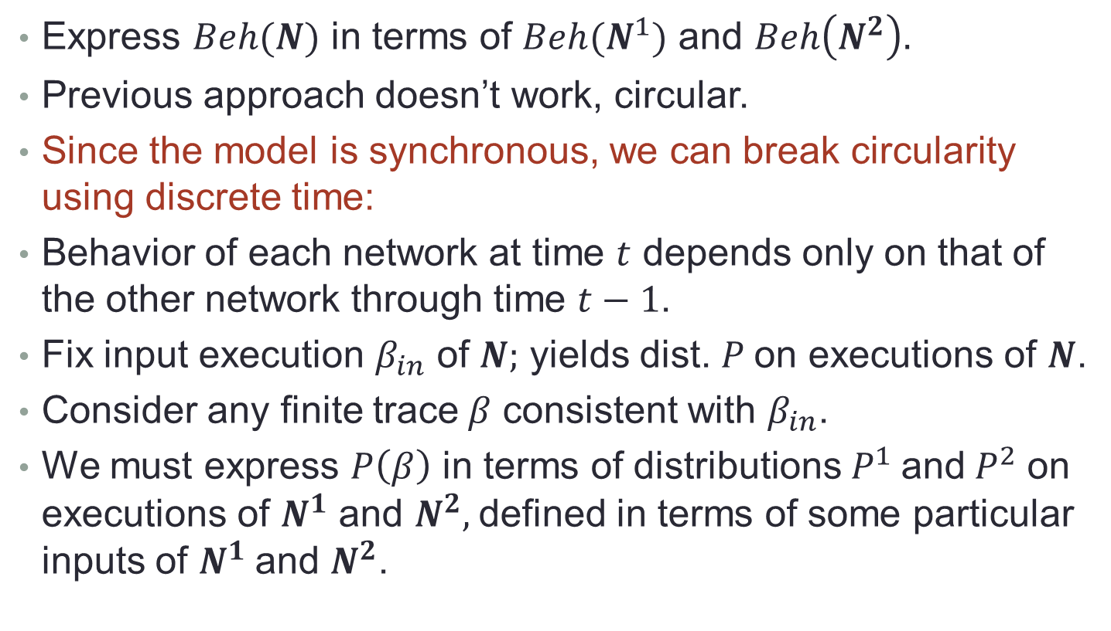
4. General Compositionality
Express $Beh(N)$ in terms of $Beh(N^{1})$ and $Beh\left(N^{2}\right).$
Previous approach doesn’t work, circular.
Since the model is synchronous, we can break circularity using discrete time:
Behavior of each network at time $t$ depends only on that of the other network through time $t−1$.
Fix input execution $β_{in}$ of $N;$ yields dist. $P$on executions of $N$.
Consider any finite trace$β$ consistent with $β_{in}$.
We must express $P\left(β\right)$ in terms of distributions $P^{1}$and$P^{2}$ on executions of $N^{1}$ and $N^{2},$defined in terms of some particular inputs of $N^{1}$and $N^{2}$.
Notes:
$N^{1} \text{and} N^{2},$can be connected in both directions$.$
Previous result broke circularities using “space”.
Now we use time instead.

Slide 50
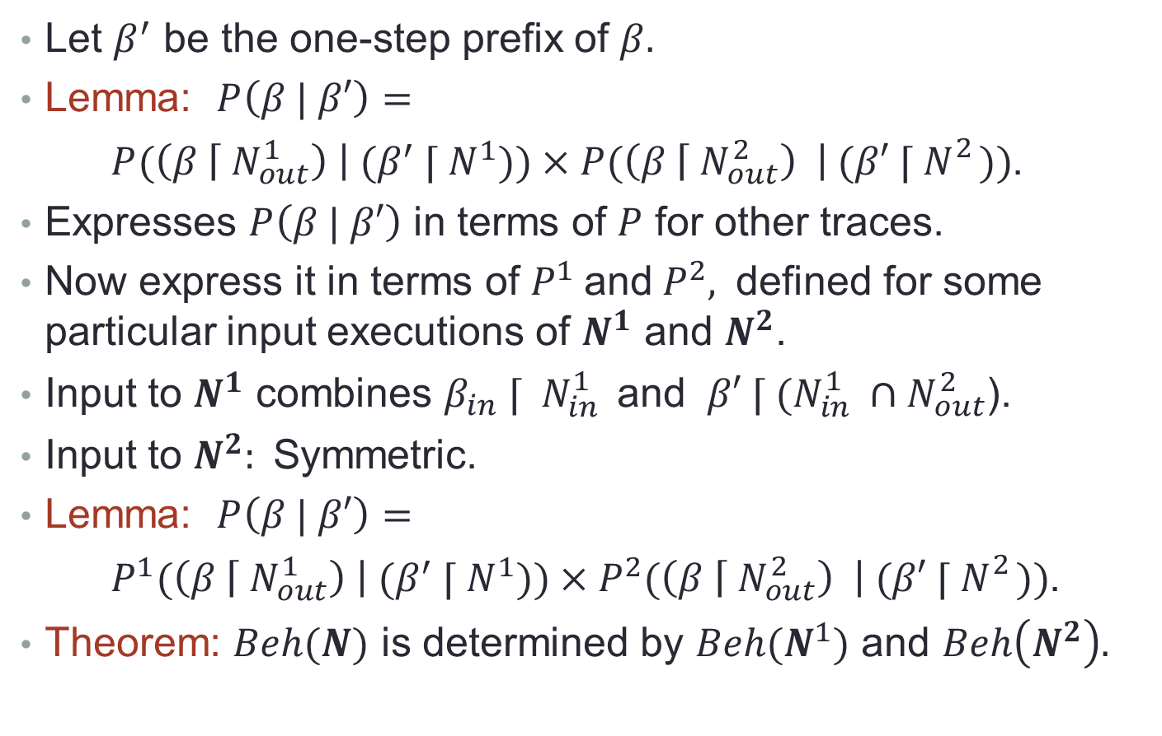
General Compositionality
Let $β^{′}$ be the one-step prefix of $β.$
Lemma: $P\left(β | β′\right)=$
$P(\left(β \left\lceil { N}_{out}^{1 }\right) \right| (β^{′}{ ⌈ N}^{1}))×P(\left(β \left\lceil { N}_{out}^{2}\right) \right|{ (β′ ⌈ N}_{}^{2}))$.
Expresses $P\left(β | β′\right)$ in terms of $P$ for other traces.
Now express it in terms of $P^{1}$and$P^{2},$ defined for some particular input executions of $N^{1}$ and $N^{2}$.
Input to $N^{1}$ combines $β_{in} ⌈ { N}_{in}^{1 }$and $β′ ⌈ (N_{in }^{1 }$ $∩{ N}_{out}^{2}$).
Input to $N^{2}:$Symmetric.
Lemma: $P\left(β | β′\right)=$
$P^{1}(\left(β \left\lceil { N}_{out}^{1 }\right) \right| (β^{′}{ ⌈ N}^{1}))×P^{2}(\left(β \left\lceil { N}_{out}^{2}\right) \right|{ (β′ ⌈ N}_{}^{2}))$.
Theorem: $Beh(N)$ is determined by $Beh(N^{1})$ and $Beh\left(N^{2}\right).$
Notes:
Work in terms of the conditional probabilities.
Can break down the probabilities of the last-round outputs into a product, since the last-round activity is independent in the two subnetworks---each depends only on the prefix through time t-1.
This lemma about decomposing conditional probabilities implies compositionality for our behavior notion Beh.
See the paper for details.
Essentially, we are regarding the conditional probabilities as an alternative, “equivalent” behavior notion.

Slide 51
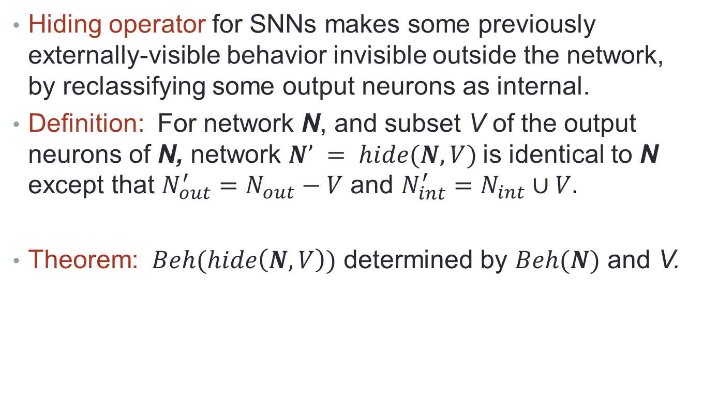
5. Hiding for SNNs
Hiding operator for SNNs makes some previously externally-visible behavior invisible outside the network, by reclassifying some output neurons as internal.
Definition: For network N, and subset V of the output neurons of N, network $N’ = hide(N,V)$is identical to N except that $N_{out}^{′}=N_{out}−V$ and $N_{int}^{′}=N_{int}∪V.$
Theorem: $Beh(hide\left(N,V\right))$ determined by $Beh(N)$ and V.
Notes:
Can use the hiding operator in conjunction with a composition operator: compose two networks and hide the neurons that were used to communicate between them.
In our model, that would say that these neurons are ineligible for use in further composition.

Slide 52
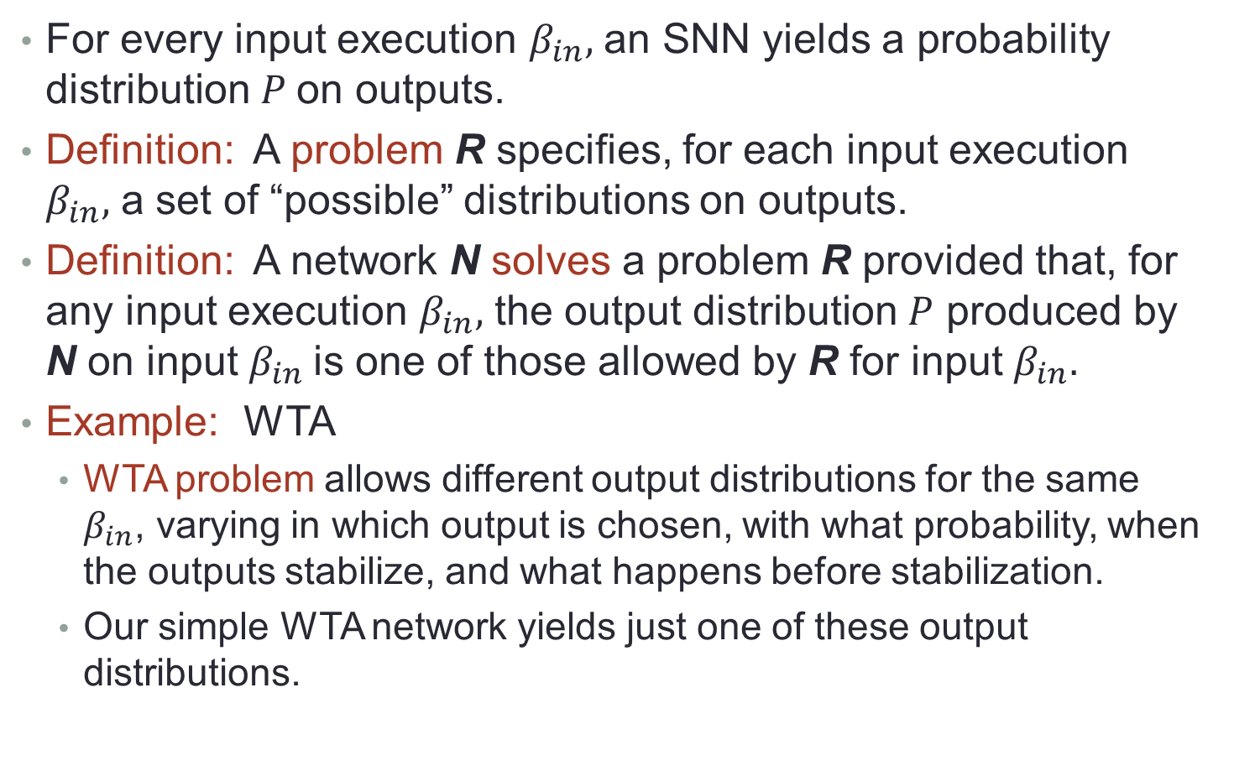
6. Problems for SNNs
For every input execution $β_{in},$ an SNN yields a probability distribution $P$on outputs.
Definition: A problem R specifies, for each input execution $β_{in},$ a set of “possible” distributions on outputs.
Definition: A network N solves a problem R provided that, for any input execution $β_{in},$ the output distribution $P$ produced by N on input $β_{in}$is one of those allowed by R for input $β_{in}.$
Example: WTA
WTA problem allows different output distributions for the same $β_{in}$, varying in which output is chosen, with what probability, when the outputs stabilize, and what happens before stabilization.
Our simple WTA network yields just one of these output distributions.

Slide 53
Problems for SNNs
Definition: Composition of problems, $R^{1}×R^{2}.$
Theorem: If $N^{1}$solves problem $R^{1}$ and $N^{2}$solves problem $R^{2}$, then $N^{1}×N^{2}$ solves problem $R^{1}×R^{2}.$
Definition: Hiding of problems, $hide(R,V).$
Theorem: If $N$solves problem $R^{}$and $V$ is a subset of the output neurons of $N$, then $hide(N,V)$ solves $hide(R,V).$
Notes:
Define composition of problems, analogous to the definition of composition of networks.
So this justifies defining subproblems to be solved by parts of the network, and reasoning about the network in terms of the subproblem specifications.

Slide 54
IV: Learning of hierarchically-structured concepts
Nancy Lynch
Frederik Mallmann-Trenn
Notes:
Which brings us, finally, to the current paper, on compositional modeling.

Slide 55
Learning of Structured Concepts
Lynch, Mallmann-Trenn. Learning Hierarchically-Structured Concepts. arXiv:1909.04559v4, January, 2021. Neural Networks 2021.
Notes:
Abstract:
We use a recently developed synchronous Spiking Neural Network (SNN) model to study the problem of learning hierarchically-structured concepts. We introduce an abstract data model that describes simple hierarchical concepts. We define a feed-forward layered SNN model, with learning modeled using Oja’s local learning rule, a well known biologically-plausible rule for adjusting synapse weights. We define what it means for such a network to recognize hierarchical concepts; our notion of recognition is robust, in that it tolerates a bounded amount of noise.
Then, we present a bottom-up learning algorithm by which a layered network may learn to recognize hierarchical concepts according to our robust definition. We analyze correctness and performance rigorously; the amount of time required to learn each concept, after learning all of the sub-concepts, is approximately $$O(1/(\backslash eta k) (\backslash lmax log\left(k\right)+\frac{1}{\backslash epsilon})+ \backslash log(k))$$,
where k is the number of sub-concepts per concept, lmax is the maximum hierarchical depth, η is the learning rate, ε describes the amount of uncertainty allowed in robust recognition, and b describes the amount of weight decrease for "irrelevant" edges. An interesting feature of this algorithm is that it allows the network to learn sub-concepts in a highly interleaved manner.
This algorithm assumes that the concepts are presented in a noise-free way; we also extend these results to accommodate noise in the learning process. Finally, we give a simple lower bound saying that, in order to recognize concepts with hierarchical depth two with noise-tolerance, a neural network should have at least two layers. The results in this paper represent first steps in the theoretical study of hierarchical concepts using SNNs. The cases studied here are basic, but they suggest many directions for extensions to more elaborate and realistic cases.

Slide 56
1. Introduction
Q: How are concepts with structure represented in the brain? How are they recognized? How are they learned?
Inspiration: Network dissection in deep Convolutional Neural Networks for computer vision [Zhou, Bau, Oliva, Torralba 19].
Lower layers of the network learn basic concepts, higher layers learn successively higher-level concepts.
Consistent with research on visual processing in mammalian brains [Hubel, Wiesel 1959].
General thesis: Structure that is naturally present in concepts gets mirrored in its brain representation, in some way that facilitates both learning and recognition.
We approach this problem using our SNN-based methods.
Notes:
Much research is devoted to understanding how the brain learns, and trying to mimic that in machine learning algorithms.
Most of that research is based on representing the learned concepts as unstructured abstract vectors.
I believe that an important aspect of learning is known structure in the data.
This project begins to address how structured concepts are represented, recognized, and learned in the brain.
Inspiration:
Computer vision, for hierarchical learning.
Other types of structure might include relationships among the concepts.
Geometric, physical structure.

Slide 57
Introduction
Initial project: Concept hierarchies, in which concepts are built from lower-level concepts, etc.…
Example: Human consists of a body, a head, two legs,…; Head consists of eyes, nose, mouth, etc.
Simplifications:
Ignore additional structure, e.g., arms and legs are positioned symmetrically.
Our hierarchies are complete trees, with the same number of children for every concept
We expect these restrictions can be weakened, but TBD.
Notes:
Simplifications:
Most hierarchical concepts in real life have additional structure, e.g., arms and legs are positioned symmetrically; we ignore this here, consider just the hierarchy.
We are also blurring issues of generalization, that is, the distinction between a particular human and the general notion of a human.
For now, I think we could consider particular humans, but generalization should be considered.
We assume our hierarchies are trees, actually forests, always with the same height and same number of children.
This is clearly a drastic over-simplification, but it yields simpler complexity analysis.
Presumably, we can weaken these assumptions quite a bit.

Slide 58
What we do:
Define concept hierarchies, and a layered SNN model.
Define what it means for a layered SNN to recognize a particular concept hierarchy; notion is robust to bounded noise.
Define what it means for a layered SNN to learn a concept hierarchy.
Two algorithms (SNNs) that can learn to recognize concept hierarchies (with/without noise during learning).
A preliminary lower bound showing that, in order to recognize concepts with hierarchical depth 2, an SNN must have at least 2 layers.
Notes:
Lower bound:
For a simple special case of concepts with hierarchical depth 2.
In an earlier version of the paper, available from arXiv, we had a version of the result for larger l.
But for l \geq 3, we needed a non-interference assumption that limits the possible interactions between firing that results from different concepts.
This is rather strong, so we dropped the result from the later paper.
It would be nice to extend the lower bound.

Slide 59
2. Data model: Preliminaries
General constants:
$l_{max}$, the maximum level number for the concepts we consider.
$n,$ the total number of lowest-level concepts, for all possible concept hierarchies.
$k,$ the number of top-level concepts in a concept hierarchy, also the number of children for each non-leaf concept.
$r_{1},r_{2}, r_{1}≤r_{2},$ lower and upper thresholds for noisy recognition.
Universal set D of all possible concepts, partitioned into levels, $D_{0},D_{1},…, D_{lmax}$.
$\left|D_{0}\right|=n.$
Notes:
All of these drastic restrictions could, presumably, be weakened.

Slide 60
Concept hierarchies
A concept hierarchy C consists of a set $C⊆D$of concepts arranged into a forest.
Levels $0,…,l_{max}$.
$k$ top-level concepts, and uniform degree $k$.
For concept $c∈C_{ℓ},$ define $children\left(c\right), descendants\left(c\right).$
$leaves\left(c\right)=$level $0$ descendants of $c$.
$$l_{max}$$
0
Notes:
Cl is notation for the Dl concepts in C.
All of these drastic restrictions could, presumably, be weakened.

Slide 61
Support
Useful in defining robust recognition.
Fix a concept hierarchy C.
For ratio $r∈\left[0,1\right],$ recursively define which concepts are $r$-supported by a particular set $B$ of level $0$ concepts:
$B_{0}=B$.
$B_{1}$ $=$ level $1$ concepts with at least an $r$-fraction of their children in $B_{0}$.
…
$B_{l} =$ level $l$ concepts with at least an $r$-fraction of their children in $B_{l−1}$.
…
$B_{lmax} =$ level $l_{max}$ concepts with at least an $r$-fraction of their children in $B_{lmax−1}$.
Special case $r=1$corresponds to a noise-free notion of support, in which all leaves must be present.
Notes:
Propagate “enough” support up the hierarchy.
Fundamental definition, for hierarchical concepts.

Slide 62
3. Network model: Preliminaries
$${l′}_{max}$$
Etc.
Etc.
Constants:
${l′}_{max},$ maximum layer number.
$n$, number of distinct inputs the network can handle (same as $n$ for the number of level 0 concepts).
$τ,$ firing threshold for neurons (here deterministic, not stochastic).
$η,$ learning rate for our learning rule.
0
Notes:
We used a deterministic threshold here because it was simpler, and we didn’t need the stochasticity for any purpose (like symmetry-breaking or sampling).
Presumably, using a probabilistic threshold would add some little complications to the analysis throughout.

Slide 63
Network structure
$${l′}_{max}$$
Etc.
Feed-forward, layered network N.
${l′}_{max}$ layers.
Each layer contains $n$ neurons.
All-to-all connections between consecutive levels.
Assume each level $0$concept $c$ in the universe $D$of concepts has a unique representation neuron $rep(c)$ in layer $0$.
Later, we will extend the $rep()$function from level $0$concepts to higher-level concepts; achieved by a learning algorithm.
Etc.
0
Notes:
Connections go upwards in the diagram.

Slide 64
Neuron states
$${l′}_{max}$$
Etc.
All neurons have a firing status flag in $\left\{0,1\right\}$, indicating whether the neuron is currently firing.
Etc.
0
Higher layer neurons also keep track of weights of incoming edges, represented by $n$-vectors of reals in the range $\left[0,1\right].$
Higher layer neurons also record whether they are currently engaged in learning, with a Boolean flag.
Corresponds to the notion of eligibility trace from neuroscience.
Notes:
A convenient way to representing edge weights was as a vector state component of the target neuron.
Avoids having extra mechanism in the model.
How is the engaged flag set?
There must be some external “scheduling” signal.
Remains to be studied, to see what is bio-plausible and also works in the algorithms

Slide 65
Neuron transitions
$${l′}_{max}$$
Etc.
Activation function: We use a deterministic threshold $τ$, rather than stochastic (for simplicity).
Etc.
0
Learning rule: Oja’s rule for weight updates [Oja 1982], for a neuron $u$that is currently engaged:
$w\left(t\right)=w\left(t−1\right)+η z(x(t−1)−z w(t−1))$ , where
$η$is the learning rate,
$x\left(t−1\right)$ is the vector of input firing status values,
$z$ is the dot product of$x\left(t−1\right)$ and $w(t−1),$which is the incoming potential at $u$ for round $t.$
Network operation: At each round $t$, first calculate incoming potential, then use activation function to determine the new firing status, then (if engaged) use Oja to update the weights.
Notes:
Inputs are controlled from outside, as usual.
So this slide describes what happens for non-input neurons.
Let w be the weight vector.
The rule is:
w(t) = w(t-1) + eta z( x(t-1) – z w(t-1) )
Where eta is the learning rate, and z is the dot product of x(t-1) and w(t-1).
z measures how close the weight vector w aligns with the input vector x.
Amount of change thus depends on both a specified learning rate and the closeness of alignment with input.
The expression in parentheses has two terms.
The first picks out which input neurons are firing, and so this describes positive adjustment of the weights for those neurons.
The second term reduces the weights on all the edges, by an amount that depends on the closeness of the alignment and the size of the previous weights of the edges.
Basically, this rule increases weights for the inputs that are firing and decreases the others.
Oja’s rule is considered biologically plausible, and is widely studied in neuroscience.
It works out nicely in terms of mathematics, having the effect of “normalizing” the weights---when it increases some, it decreases others, so the weights don’t “blow up”.

Slide 66
4. Problem statements
Two problems:
Recognizing a concept hierarchy, and
Learning to recognize a concept hierarchy.
We assume here that each item is represented by exactly one neuron (over-simplification, or perhaps an abstraction).
In both cases, we are interested in noisy recognition, captured formally using two fractions (ratios) $r_{1},r_{2}∈$ ${\left[0,1\right], r}_{1}≤r_{2}$.
For recognition, assume a particular concept hierarchy, C.
For learning, we must accommodate any arbitrary concept hierarchy C that might be presented as input.
Presenting a set $B$ of level $0$ concepts: Allow exactly the $reps(B)$ input neurons to fire (together).
Notes:
So the recognition problem is stated in terms of a particular rep() neuron firing.
Representation by exactly one neuron is of course an over-simplification, but:
It would be interesting to extend this work to multiple representations per concept, perhaps disjoint or possibly overlapping as in Valiant’s work.
Perhaps this could be regarded as simply an abstraction, and some lower level of abstraction could involve multiple representations and could be shown to implement this simplified model with some good probability.

Slide 67
The robust recognition problem
Support (recall):
Assumes a particular concept hierarchy C.
For ratio $r∈\left[0,1\right],$ recursively define which concepts are $r$-supported by a particular set $B$ of level $0$ concepts:
$B_{0}=B$.
$B_{1}$ $=$ level $1$ concepts with at least an $r$-fraction of their children in $B_{0}$.
$B_{l} =$ level $l$ concepts with at least an $r$-fraction of their children in $B_{l−1}$.
For ratios $r_{1},r_{2}, r_{1}≤r_{2},$ network N $\left(r_{1},r_{2}\right)$-recognizes concept hierarchy C provided that for each concept $c∈C:$
Concept $c$has a unique representation neuron $rep\left(c\right).$
Suppose that a set $B$ of level 0 concepts in $C$ is presented. Then:
If $c$ is $r_{2}$-supported by $B$ then $rep(c)$ must fire.
if $c$is not $r_{1}$-supported by B then $rep(c)$ must not fire.
E.g., consider $r_{1}=\frac{1}{3}, r_{2}=\frac{2}{3}.$
Notes:
The definition of support used in both the positive and negative cases is recursive.
To recognize, you should have “enough” support, all the way up the hierarchy.
We use two ratios r1 and r2 to capture the possibility of a middle ground, where recognition might or might not occur.
C is the set of concepts in the hierarchy C.
The firing here must occur at the right time---this is the time when B is “presented” plus the number of the layer where the rep appears.
These values of r1 and r2 are examples that are achievable, and seem biologically realistic.
Perspective:
Valiant did some possibly-related work in his “Memorization and Association” paper, to try to reduce the situations where the system wound up in the middle ground.
In our case, avoiding the middle ground would be a consequence of presenting sufficiently separated/clustered inputs to the network; otherwise it might get confused.
Seems biologically plausible.
But it remains to try to understand clearly the connection with Valiant’s work here.

Slide 68
Learning problem (noise-free learning)
Here, the network N initially doesn’t know which concept hierarchy it should learn; suppose in some execution, a particular concept hierarchy C is to be learned.
To show a concept $c,$present all its leaves (level 0 descendants).
Work bottom-up, showing each concept only after each of its children has been shown “sufficiently many” times ($σ$times, for a parameter $σ$).
Otherwise, arbitrary interleaving is allowed.
Then after “not too long”, the network N should reach a state from which it $\left(r_{1},r_{2}\right)$-recognizes concept hierarchy C.
We say that network N $\left(r_{1},r_{2}\right)$-learns concept hierarchy C.
Notes:
Lots of interleaving is allowed, flexible order, as long as children are completely presented before we start on parents.
The interleaving could be a problem in the brain, though---there might be a cost we are neglecting, for a context-switch.
Something else we are neglecting here: Learning of lower-level concepts might be helped by first learning higher-level concepts. Or higher/lower levels might be learned in an interleaved fashion.

Slide 69
5. Algorithms
Recognition algorithm, for a given concept hierarchy C:
Embed the hierarchy in the layered network, each level at the same-numbered layer.
Weights from reps of children to reps of parents can be $1$, others $0$ (for example).
For a given $r_{1},r_{2},$set the threshold $τ$ for every non-input neuron to $\left(r_{1}+r_{2}\right)k/2.$
This network solves the $\left(r_{1},r_{2}\right)$-recognition problem for concept hierarchy C; time is just $ℓ_{max}.$
Notes:
This is a simple recognition algorithm, without regard to how the weights are learned.
The ratio constants r1 and r2 must be in the range [0,1].
This should be easy to see.
The time is just what is needed for the signals to propagate up the layers to the rep neuron.

Slide 70
Learning algorithm
Assume the network starts in a “clean state”, where weights are all $1 /$ $k^{ℓmax}.$
Threshold $τ=(r_{1}+r_{2})√k$ / 2.
Use a bottom-up discipline for showing the concepts in C:
To show a concept $c,$present all its leaves (level 0 descendants).
Work bottom-up in the concept hierarchy, showing each concept only after each of its children has been shown $σ$times, for a parameter $σ$.
Otherwise, arbitrary interleaving is allowed.
Given these inputs and starting conditions, network just executes normally, following the given activation function and Oja’s learning rule.
Results in learning the concepts in C bottom-up.

Slide 71
Learning algorithm
Level $l$ concepts acquire representations in layer $l$; the algorithm embeds the hierarchy in the network graph, level by level.
When trying to learn a level $l$ concept $c$:
We assume (inductively) that each of $c^{′}s$ children has already acquired a $rep$ in layer $l−1$, which has already learned to fire in response to presentation of its leaves.
So presenting all the $reps$of all the leaves of $c$ together results in firing of the $reps$ of all these children.
These induce potential at layer $l$ neurons.

Slide 72
Learning algorithm
When trying to learn a level $l$ concept $c$:
We assume (inductively) that each of $c{}_{}^{′}s$ children has already acquired a $rep$ in layer $l−1$, which has already learned to fire in response to presentation of its leaves.
So presenting all the $reps$of all the leaves of $c$ together results in firing of the $reps$ of all these children.
These induce potential at layer $l$ neurons.
We use a Winner-Take-All module to select one neuron $u$ (the one with the highest potential), and put it into “engaged” mode for learning.
Neuron $u$ learns using Oja’s rule: Incoming edges from $reps$ of $c$’s children get strengthened, others get weakened.
Even one step ensures that the same $u$will later be selected for the same concept $c,$and $u$will not later be selected for any other concept.
After $c$ has been shown $σ$ times, $u$will have learned to fire in response to presentation of all its leaves, and in fact, to a sufficient fraction of the leaves.
Notes:
The use of WTA ensures that we get only one rep for the concept c.
In our paper so far, the learning process itself (weight changes) prevent u from being selected again.
But it seems that when we consider extensions, such as limited overlap, we will want another mechanism to prevent this.
TBD.

Slide 73
Learning algorithm
Theorem 1: Let N be the network described above.
Assume that the learning rate $η$ is $\frac{ 1}{4k}.$
Let $r_{1},r_{2}∈$ ${\left[0,1\right], r}_{1}<r_{2}$.
Let $ε=\left(r_{2}−r_{1}\right)$ / ${(r}_{1}+ r_{2}).$
Let C be any concept hierarchy with max level $≤$ max layer number in N.
Suppose that the concepts in C are shown according to a $σ$–bottom-up presentation schedule, where
$σ$ = $O( (1 /η k$)($ℓ_{max}$ $\log\left(k\right)+1/ϵ$) $+ b\log\left(k\right) )$.
Then N $\left(r_{1},r_{2}\right)$-learns C.
Notes:
There is some flexibiilty in the choice of eta. But it needs both upper and lower bounds, and we decided to simplify here by just giving it a particular value.
Note that the time bound depends (inversely) on epsilon, which is a normalized difference between the two fractional values r1 and r2.
So, more learning is needed to separate closer fractions. As one might expect.
How big does b need to be?
That is not clear. b = 1 seems to be good enough for the results on non-noisy learning.
b = lmax is enough for cases where we introduce some noise into the process, see the next section.
For later extensions, we might need larger b.
This permits arbitrary interleaving of learning of incomparable concepts, since there is no interaction among the different neurons that learn.

Slide 74
Learning algorithm
Theorem 1: Let N be the network described above.
Assume that the learning rate $η$ is $\frac{ 1}{4k}.$
Let $r_{1},r_{2}∈$ ${\left[0,1\right], r}_{1}<r_{2},$ $ε=\left(r_{2}−r_{1}\right)$ / ${(r}_{1}+ r_{2}).$
Let C be any concept hierarchy with max level $≤$ max layer in N.
Suppose that the concepts in C are shown according to a $σ$–bottom-up presentation schedule, where
$σ$ = $O( (1 /η k$)($ℓ_{max}$ $\log\left(k\right)+1/ϵ$) $+ b\log\left(k\right) )$.
Then N $\left(r_{1},r_{2}\right)$-learns C.
Proof: A series of lemmas analyzing the step-by-step changes caused by using Oja’s rule.
The first term bounds the time to increase the weights of the needed edges to something in the range $[1$ / $\left(1+ε\right)\sqrt{k}, 1$/ $\sqrt{k}]$. That is, to roughly $1$/ $\sqrt{k}$.
The second term bounds the time to decrease the weights of the unwanted edges to at most $1$ / $k^{lmax+b}$.
Notes:
There is some flexibiilty in the choice of eta. But it needs both upper and lower bounds, and we decided to simplify here by just giving it a particular value.
Note that the time bound depends (inversely) on the normalized difference between the two fractional values r1 and r2.
So, more learning is needed to separate closer fractions. As one might expect.
How big does b need to be?
That is not clear. b = 1 seems to be good enough for the results on non-noisy learning.
b = lmax is enough for cases where we introduce some noise into the process, see the next section.
For later extensions, we might need larger b.
This permits arbitrary interleaving of learning of incomparable concepts, since there is no interaction among the different neurons that learn.

Slide 75
6. Extension: Noisy Learning
Bottom-up discipline for the noise-free learning algorithm:
To show a concept $c,$present all its leaves (level 0 descendants).
Work bottom-up in the concept hierarchy, showing each concept only after each of its children has been shown $σ$times, for a parameter $σ$.
Otherwise, arbitrary interleaving is allowed.
Now relax this discipline so that not all the children are shown all the time.
To show a concept $c$, randomly choose a size $pk$ subset of its children, and for each, a random size $pk$ subset of their children, etc.…(recursively).
Present the resulting set $B$of leaves of $c$.
Work bottom-up as before, showing each concept only after each of its children has been shown $σ$times, for parameter $σ$.

Slide 76
Noisy Learning
To show a concept $c$, randomly determine a size $pk$ subset of its children, and for each, a random size $pk$ subset of their children, etc.
Present the resulting set $B$of leaves of $c$.
Work bottom-up as before, showing each concept only after each of its children has been shown $σ$times, for parameter $σ$.
Theorem 2: Analogous to Theorem 1, with a larger value of $σ.$
Let N be the network described above, with a different constraint on
the learning rate $η.$
Then N $\left(r_{1},r_{2}\right)$-learns C, with high probability.
Proof: Similar to Theorem 1, but it takes somewhat longer to learn each concept, and the learning occurs only with high probability.
Notes:
The new expression is a bit complicated, refer to the paper.

Slide 77
7. Conclusions: Summary
Theoretical model for recognizing, learning hierarchically-structured concepts, in synchronous, feed-forward SNNs.
Definition of a robust recognition problem for hierarchical concepts.
Two learning algorithms, with/without noise during the learning process, leading to robust recognition.
Learn concepts bottom-up, but with arbitrary interleaving in learning incomparable concepts.
Representations produced are embeddings of the hierarchical structure in the neural network.
A preliminary lower bound on layers needed for noise-tolerant recognition, for 2-level hierarchies.

Slide 78
Discussion
A first step towards a theory of representation and learning hierarchically-structured concepts in SNNs.
Current model makes many simplifying assumptions (strict tree structure, all concepts have the same number of children, feed-forward networks, precise learning rule,…)
Needs many extensions, to capture features of real brain and computer vision algorithms:
Desirable extensions to results:
More flexible learning orders.
Robustness to a few extraneous inputs, not just missing inputs; to noise in calculating potentials; to failures of neurons or synapses.
Incorporate a WTA implementation.
Extend lower bound to more levels/layers.
Notes:
Try to strengthen the lower bound by removing assumptions, trying to base it on limiting the total network size, not just the number of layers.

Slide 79
Other future work
Variations in the network model:
Instead of all-to-all connections between layers, consider sparse random set of connections.
Edges that skip layers.
Feedback edges, between layers, or skipping layers.
Other learning rules besides Oja’s rule; one-shot learning rules.
Variations in the data model:
Different numbers of children for different concepts.
Bounded overlap between sets of children, children at different levels (concept DAG instead of forest).
Our higher-level concepts correspond to “ands” of their children; what about “ors”? “nots”?
Other relationships between concepts: association, causality, sequential order.
Notes:
Different number of children would require new ways of setting the firing thresholds; perhaps these could be “learned”.

Slide 80
Other future work
Different forms of representation:
Each concept $c$ is represented by just one neuron, $rep(c).$
Generalize to a more elaborate “code” consisting of a particular set of neurons that fire?
Cell assemblies [Palm 2012].
“Time-share" the network, allowing the same layer to represent different levels of the concept hierarchy at different times.
Experimental work:
Complement this theoretical work with simulation experiments to evaluate the performance and robustness of the algorithms.
Strengthen connections with biology.

Slide 81
Overlap and Feedback
Learning Hierarchically-Structured Concepts II: Overlapping Concepts, and Networks With Feedback. Lynch, Mallmann-Trenn. In progress.
Trying to extend results by allowing:
Limited overlap between children of different concepts.
Networks with feedback edges.

Slide 82
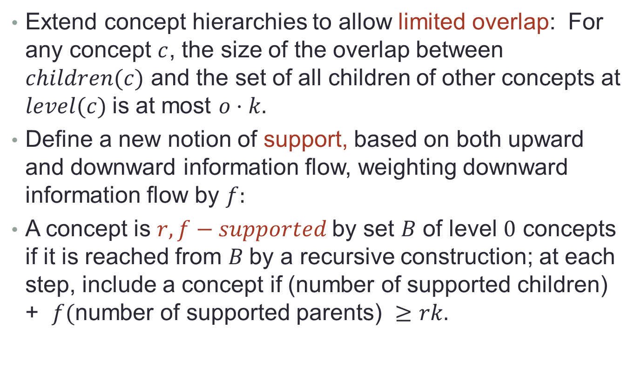
1. Data Models
Extend concept hierarchies to allow limited overlap: For any concept $c$, the size of the overlap between $children(c)$ and the set of all children of other concepts at $level(c)$is at most $o⋅k.$
Define a new notion of support, based on both upward and downward information flow, weighting downward information flow by $f:$
A concept is $r,f−supported$by set $B$ of level $0$ concepts if it is reached from $B$by a recursive construction; at each step, include a concept if (number of supported children) + $f($number of supported parents) $≥rk.$
Notes:
Weighting the parent concepts by f.

Slide 83
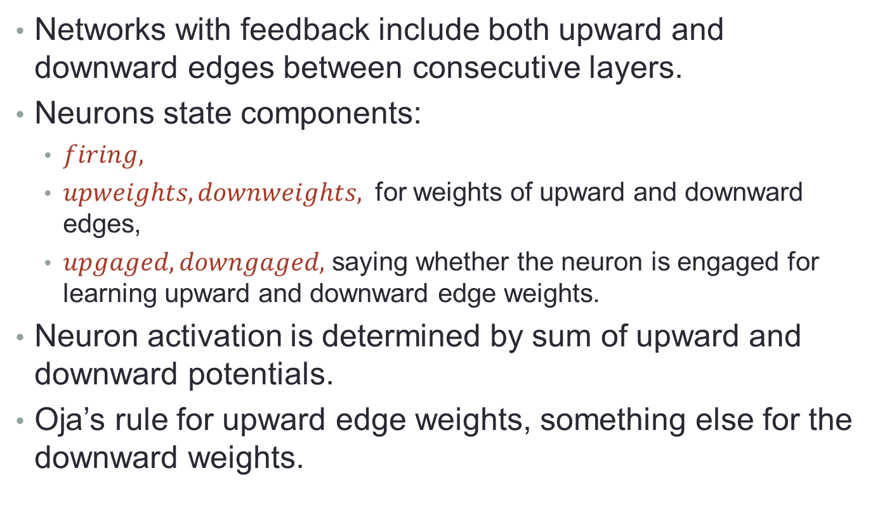
2. Network Models
Networks with feedback include both upward and downward edges between consecutive layers.
Neurons state components:
$firing,$
$upweights, downweights,$ for weights of upward and downward edges,
$upgaged, downgaged,$ saying whether the neuron is engaged for learning upward and downward edge weights.
Neuron activation is determined by sum of upward and downward potentials.
Oja’s rule for upward edge weights, something else for the downward weights.

Slide 84
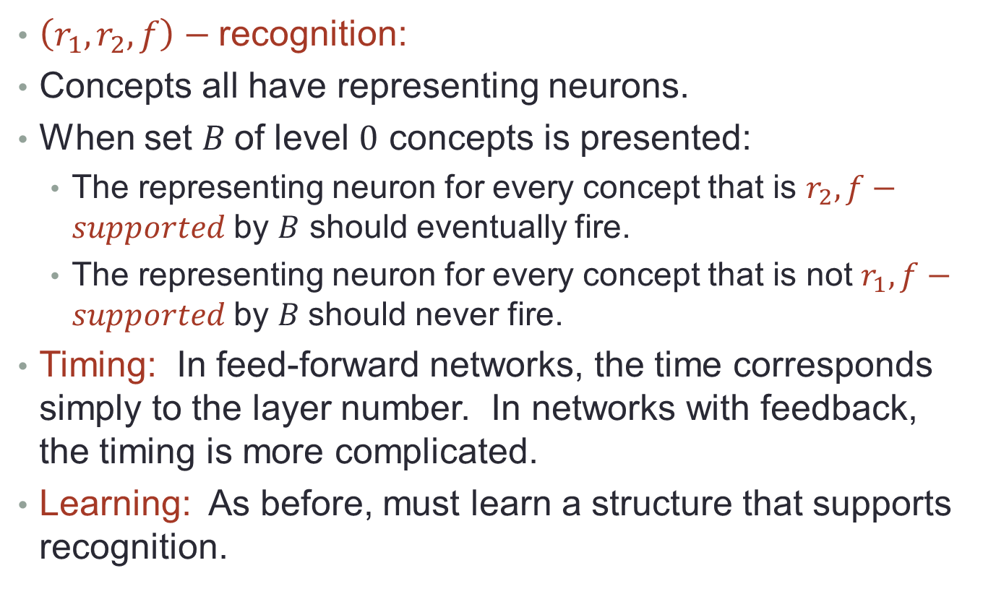
3. Problem Statements
$\left(r_{1},r_{2},f\right)−$recognition:
Concepts all have representing neurons.
When set $B$of level $0$ concepts is presented:
The representing neuron for every concept that is $r_{2},f−supported$by $B$ should eventually fire.
The representing neuron for every concept that is not $r_{1},f−supported$by $B$should never fire.
Timing: In feed-forward networks, the time corresponds simply to the layer number. In networks with feedback, the timing is more complicated.
Learning: As before, must learn a structure that supports recognition.
Notes:
We probably should also add that non-rep neurons should never fire.

Slide 85
4. Recognition Algorithms for Feed-Forward Networks
Redo, extend recognition results from previous paper.
New proofs, with more precise characterizations.
Overlap doesn’t complicate matters much, provided that the amount of overlap is sufficiently small.
Extend results to allow approximate weights, within some bounds, and scaling of weights and thresholds.

Slide 86
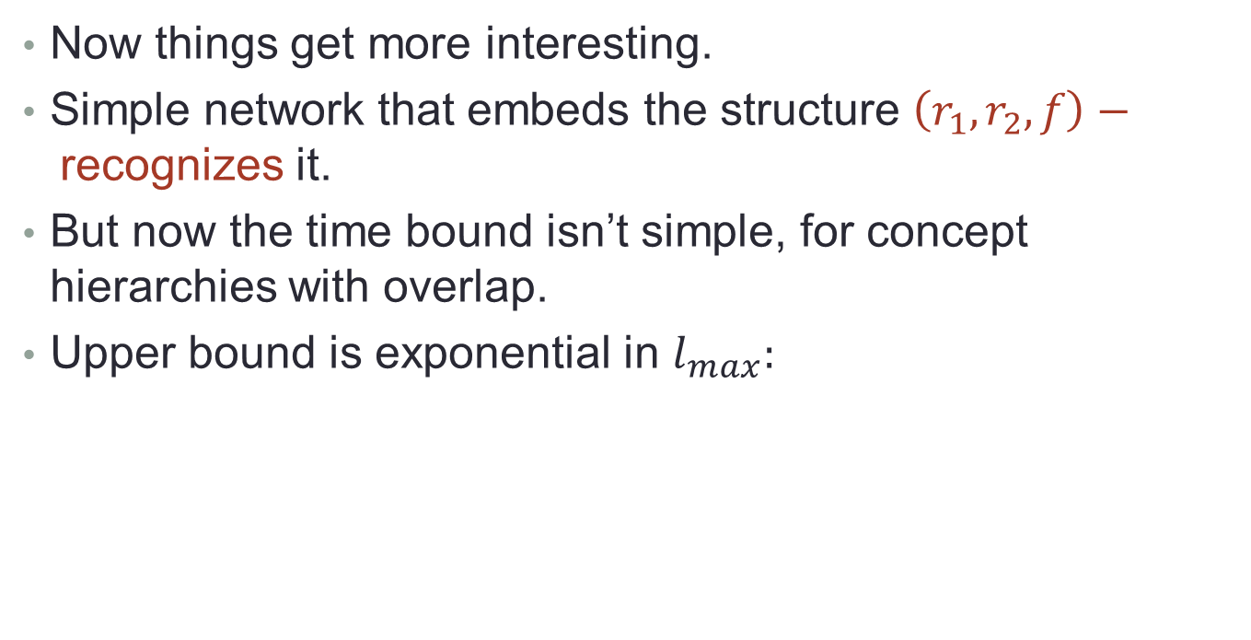
5. Recognition Algorithms for Networks with Feedback
Now things get more interesting.
Simple network that embeds the structure $\left(r_{1},r_{2},f\right)−$recognizes it.
But now the time bound isn’t simple, for concept hierarchies with overlap.
Upper bound is exponential in $l_{max}:$

Slide 87




Example: Exponential time upper bound for recognition
Extend results to approximate weights and scaling.
$$c_{1}$$
$$c_{2}$$
$$c_{3}$$
$$c_{m}$$
Notes:
Trace the order of firing the reps, from the paper p. 24.

Slide 88
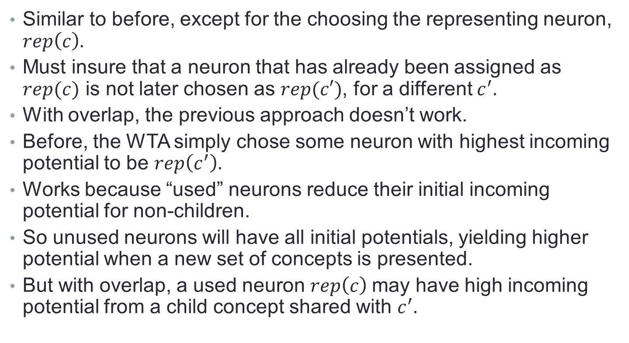
6. Learning Algorithms for Feed-Forward Networks
Similar to before, except for the choosing the representing neuron, $rep\left(c\right).$
Must insure that a neuron that has already been assigned as $rep(c)$ is not later chosen as $rep(c′)$, for a different $c^{′}.$
With overlap, the previous approach doesn’t work.
Before, the WTA simply chose some neuron with highest incoming potential to be $rep\left(c^{′}\right).$
Works because “used” neurons reduce their initial incoming potential for non-children.
So unused neurons will have all initial potentials, yielding higher potential when a new set of concepts is presented.
But with overlap, a used neuron $rep\left(c\right)$may have high incoming potential from a child concept shared with $c^{′}.$
Notes:
The incoming potential from the shared child can be big enough to swamp out the initial potentials for the unused neurons.

Slide 89
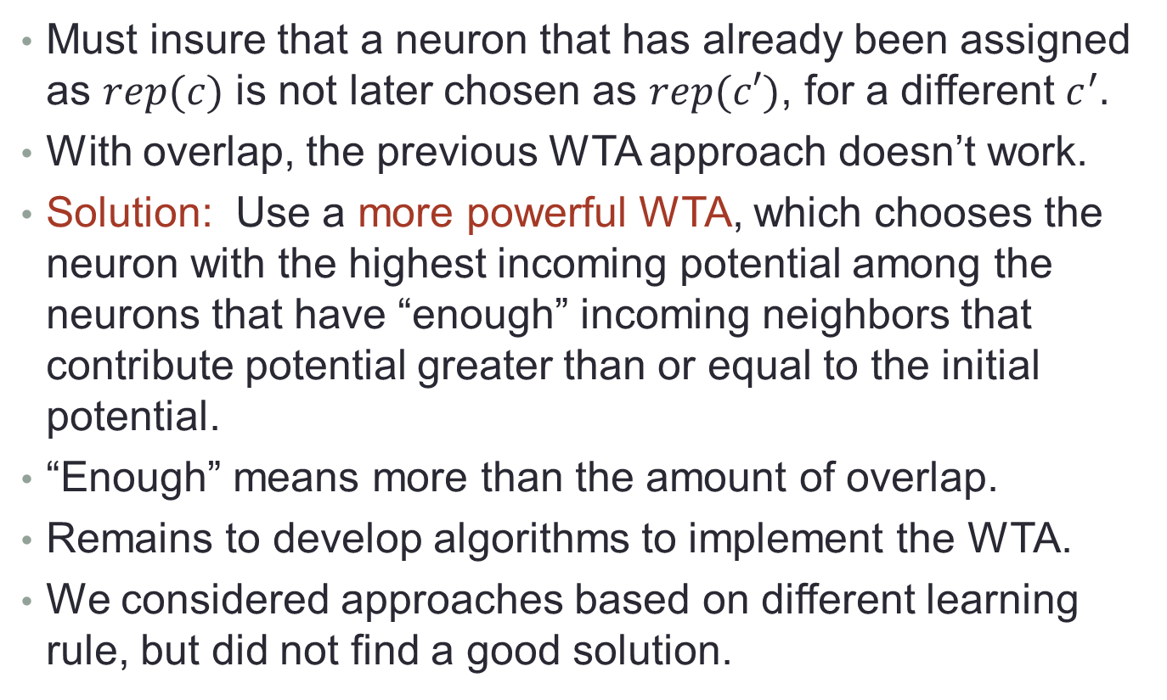
Learning in Feed-Forward Networks
Must insure that a neuron that has already been assigned as $rep(c)$ is not later chosen as $rep(c′)$, for a different $c^{′}.$
With overlap, the previous WTA approach doesn’t work.
Solution: Use a more powerful WTA, which chooses the neuron with the highest incoming potential among the neurons that have “enough” incoming neighbors that contribute potential greater than or equal to the initial potential.
“Enough” means more than the amount of overlap.
Remains to develop algorithms to implement the WTA.
We considered approaches based on different learning rule, but did not find a good solution.
Notes:
So we are considering both the potential and the number of neurons contributing to that potential.

Slide 90
7. Learning Algorithms for Networks with Feedback
Simple approach, first learn upward weights and then downward weights.
LTTR.

Slide 91
8. Conclusions
Contributions:
Formal definitions for concept hierarchies with overlap, and networks with feedback.
Analysis of time requirements for recognition, esp. for general concept hierarchies in networks with feedback.
Extensions of basic recognition results to allow approximate edge weights and scaling.
New WTA for bottom-up learning.
Simple strategy for learning weights in both directions.
Future work:
Extensions of the learning algorithms.
Different data models, network assumptions, types of representation.
Connect with experimental computer vision.

